Slide 1




Dynamic Response of a Freshwater Lens to Natural Variations in Recharge
International Academy of Science, Technology, Engineering, and Management (IASTEM)
International Conference on Environment and Natural Science (ICENS)
Seoul, South Korea
July 4, 2019
Bekah Dougher, Nathan C. Habana, Mark A. Lander, John W. Jenson
Notes:
Hello, I am Nathan Habana, and I am the principle investigator of the dynamic response of a freshwater lens to natural variations in recharge. The study was funded through the Guam Hydrologic Survey and USGS 104b and was a master’s thesis project assigned to Ms. Bekah Dougher through the University of Guam’s Graduate Studies Program - Environmental Science.

Slide 2
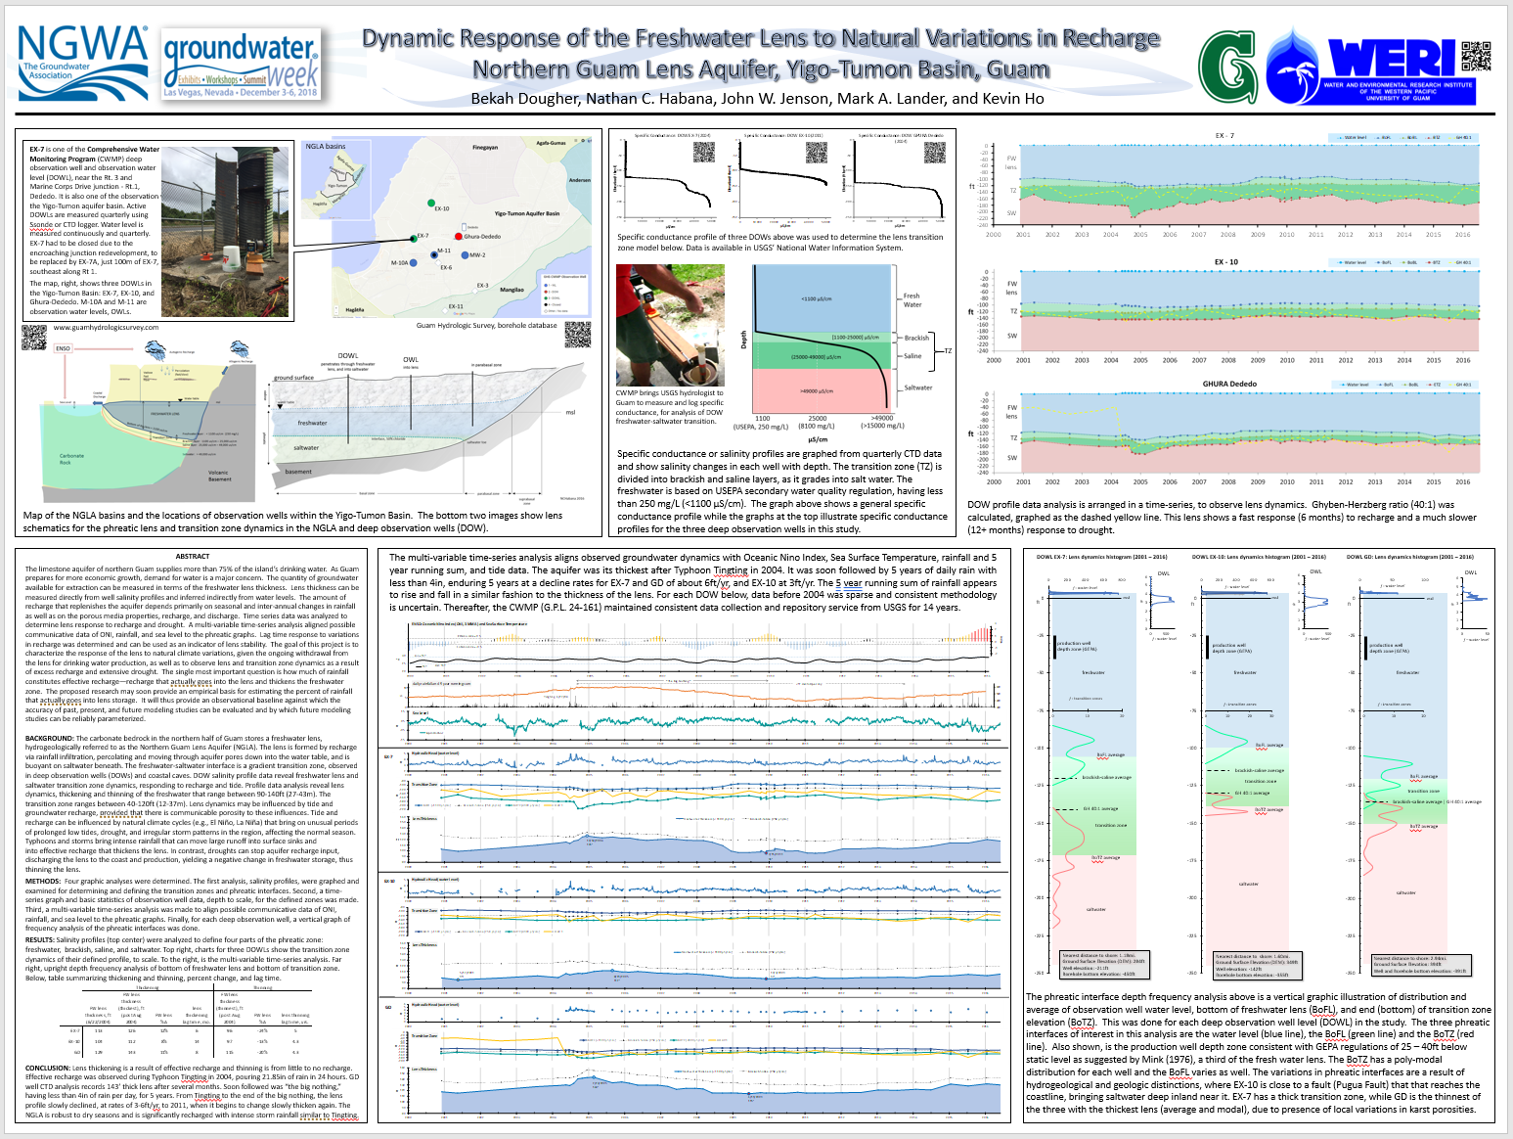
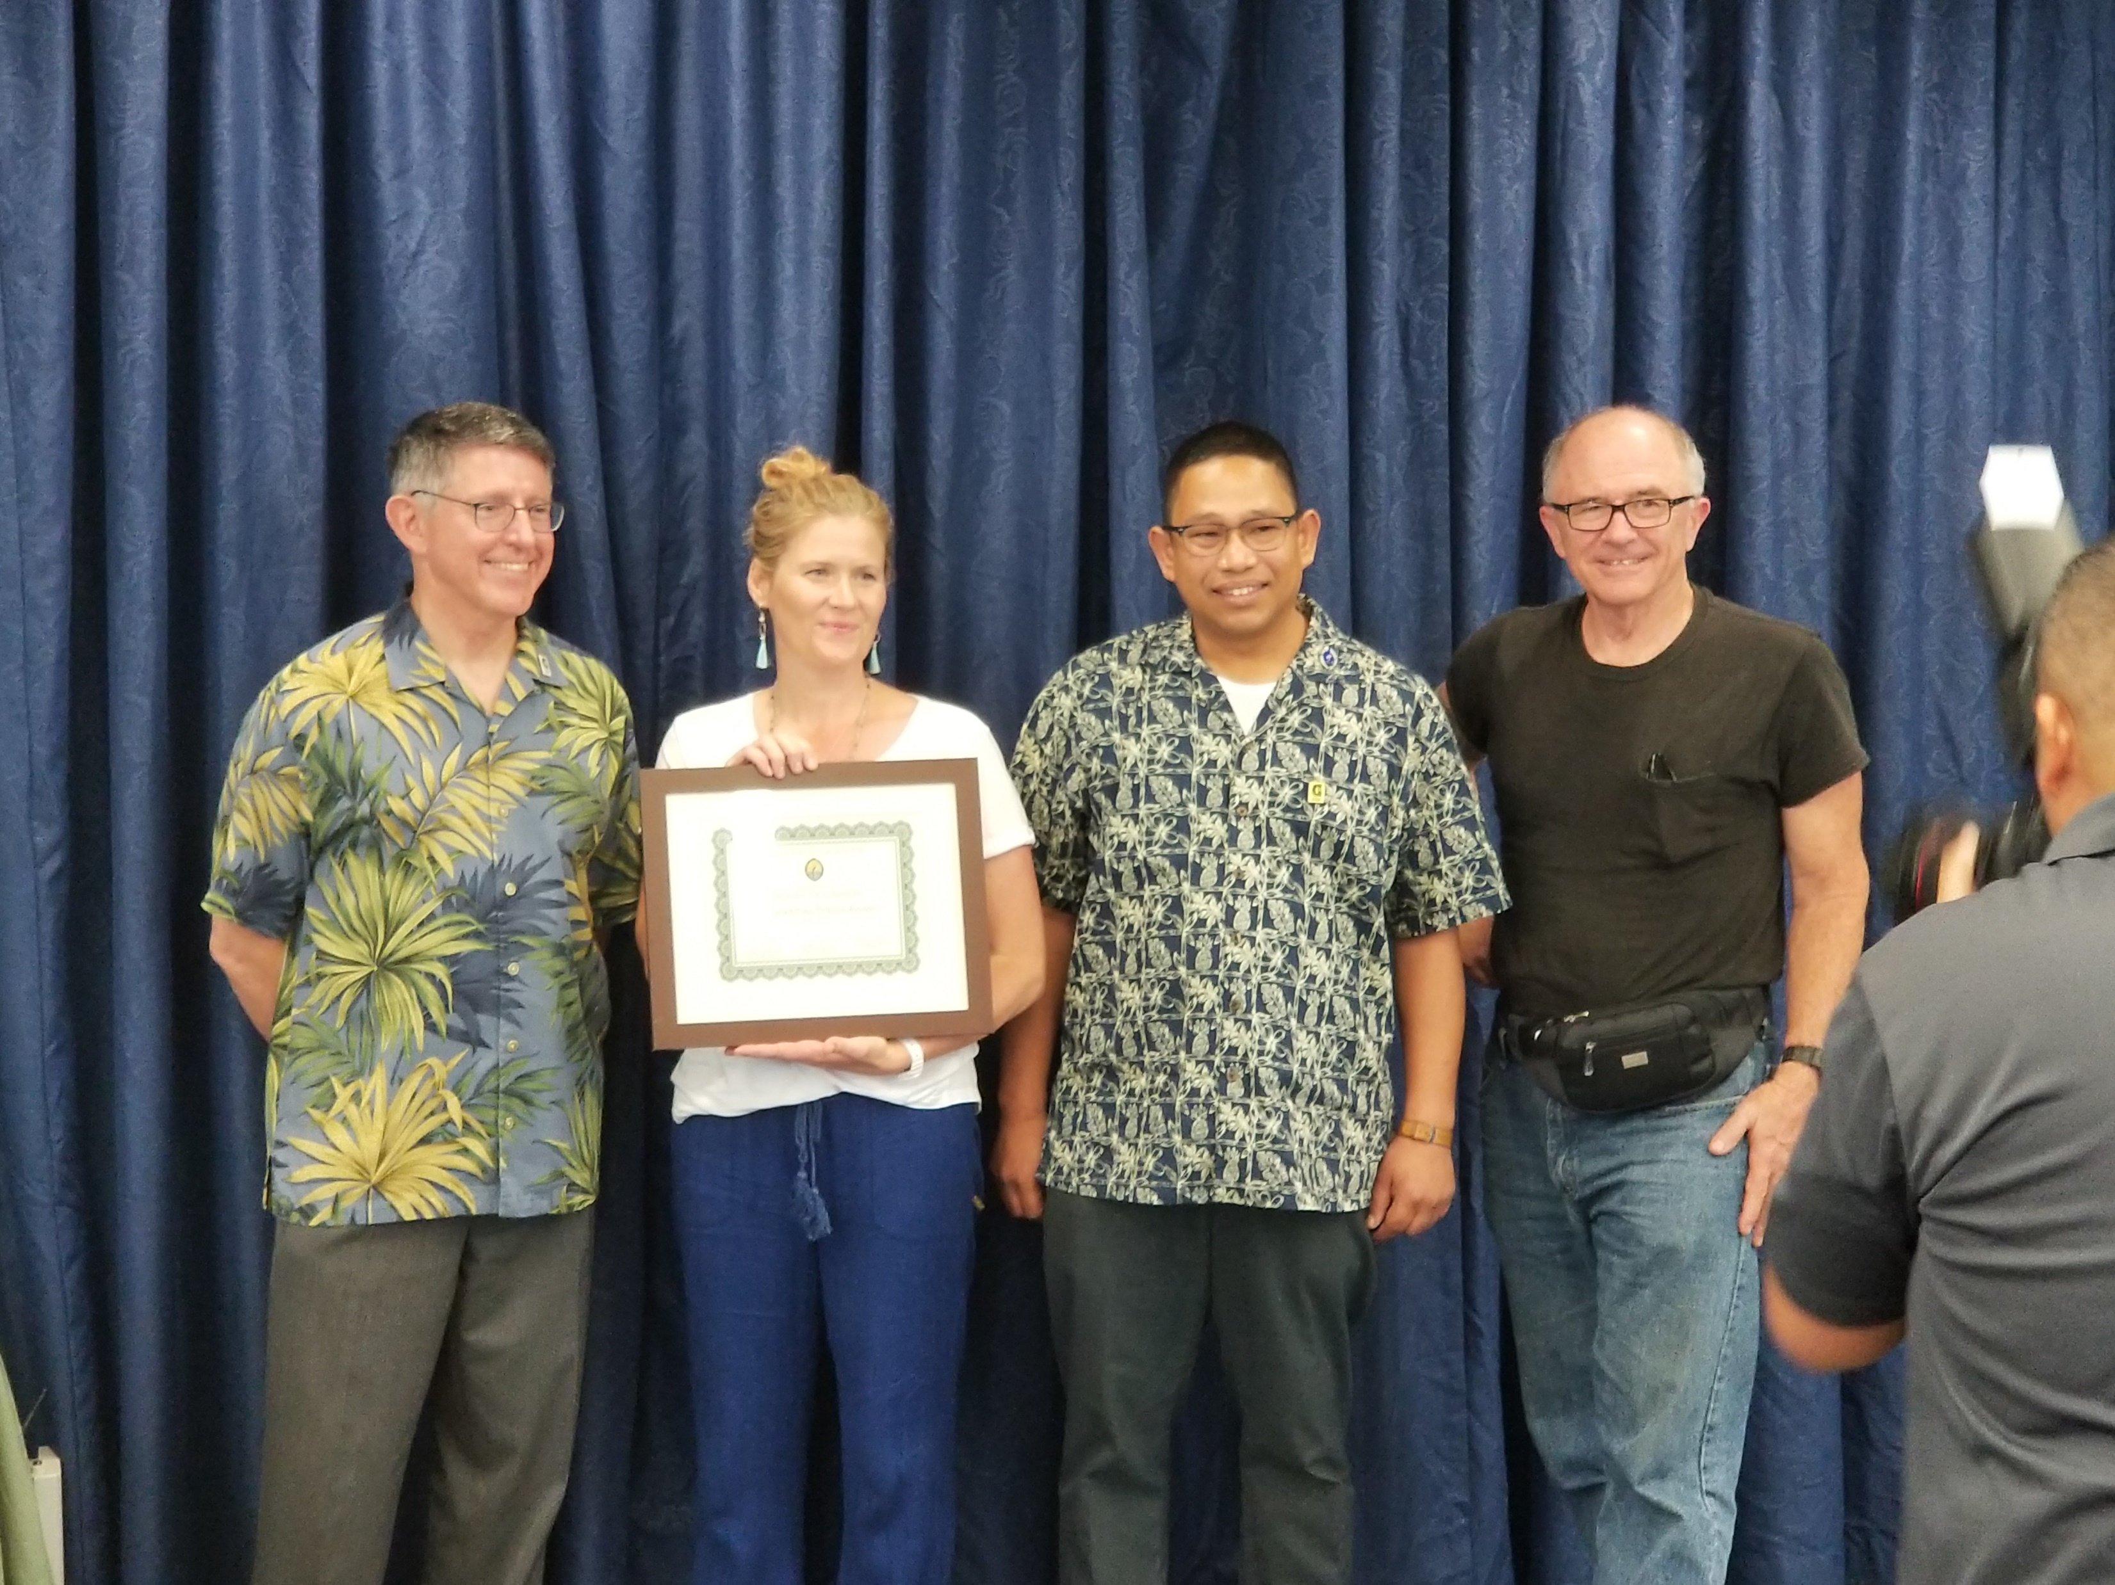
Bekah Dougher
Notes:
Bekah’s work won the farvolden scholarship in a poster presentation at the National Groundwater Association, held in Vegas, December, 2018. She just graduated in May, and was awarded the highest honor in our university’s research, the presidential thesis award.

Slide 3
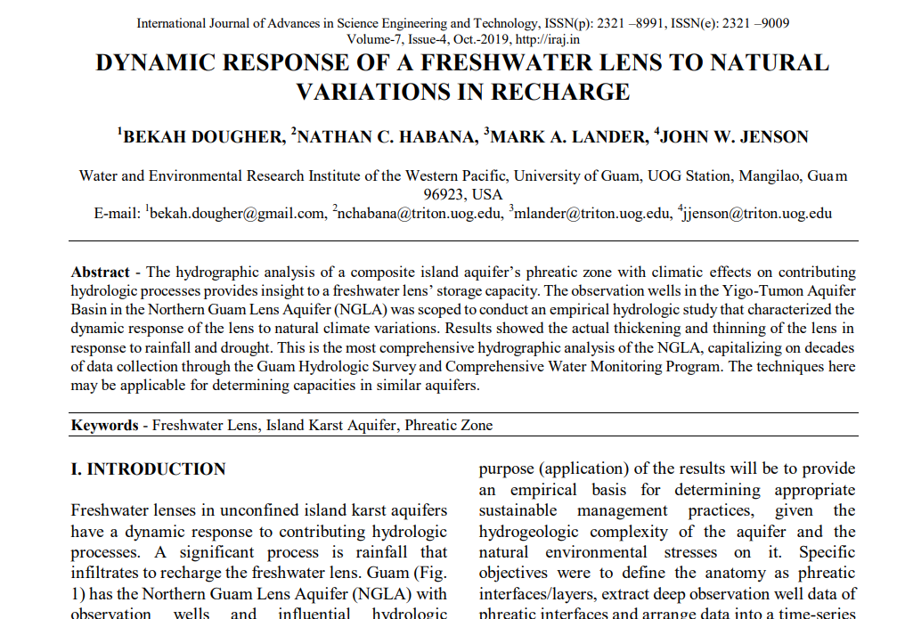
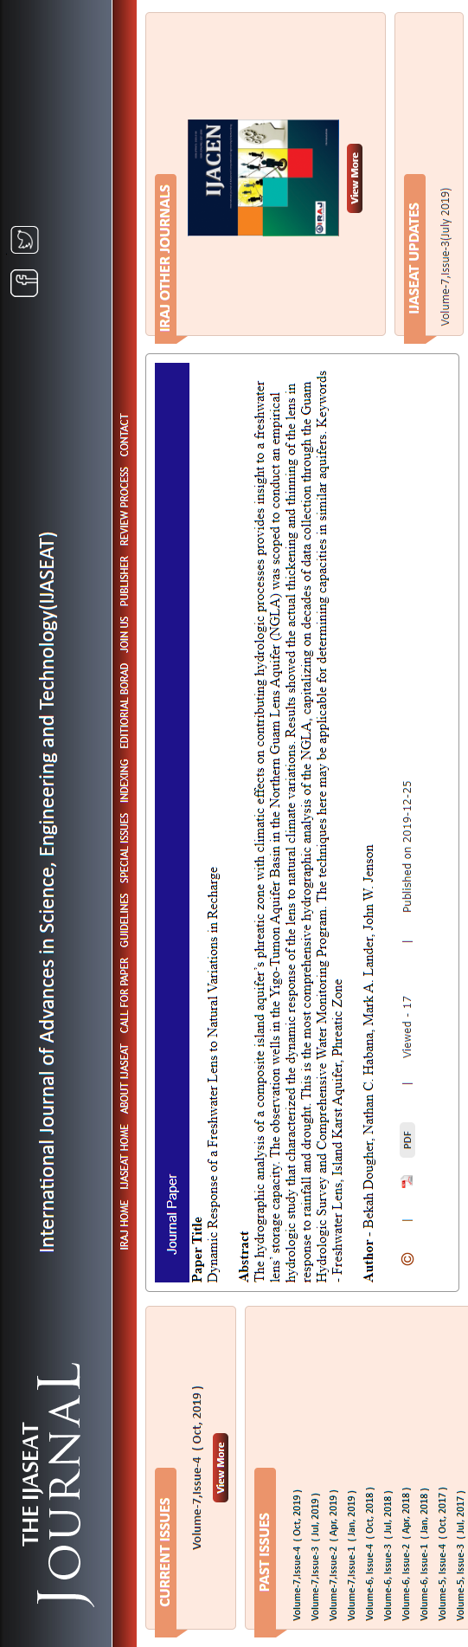

Slide 4
Presentation Outline
Introduction
Background
Yigo-Tumon Aquifer Basin
Geology, Hydrology, Hydrogeology
Freshwater Lens Dynamics
CWMP and Observation Wells
Methods
Data sources
Anatomy of Aquifer
Analysis
Results and Discussion
Contributing Hydrologic Processes and lens hydrograph
Vertical frequency analysis
Discussion
Conclusion
Notes:
my presentation outline…

Slide 5
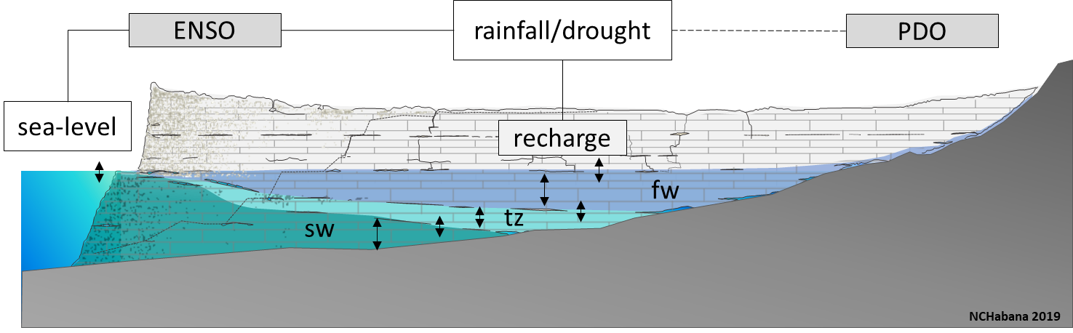
Introduction
Notes:
Freshwater lenses in unconfined island karst aquifers have a dynamic response to contributing hydrologic processes. A significant process is rainfall that infiltrates to recharge the freshwater lens. The hydrographic analysis of a composite island aquifer’s phreatic zone with climatic effects on contributing hydrologic processes provides insight to a freshwater lens’ storage capacity.

Slide 6
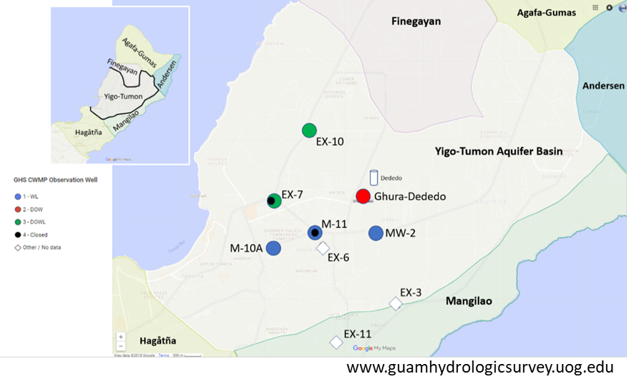
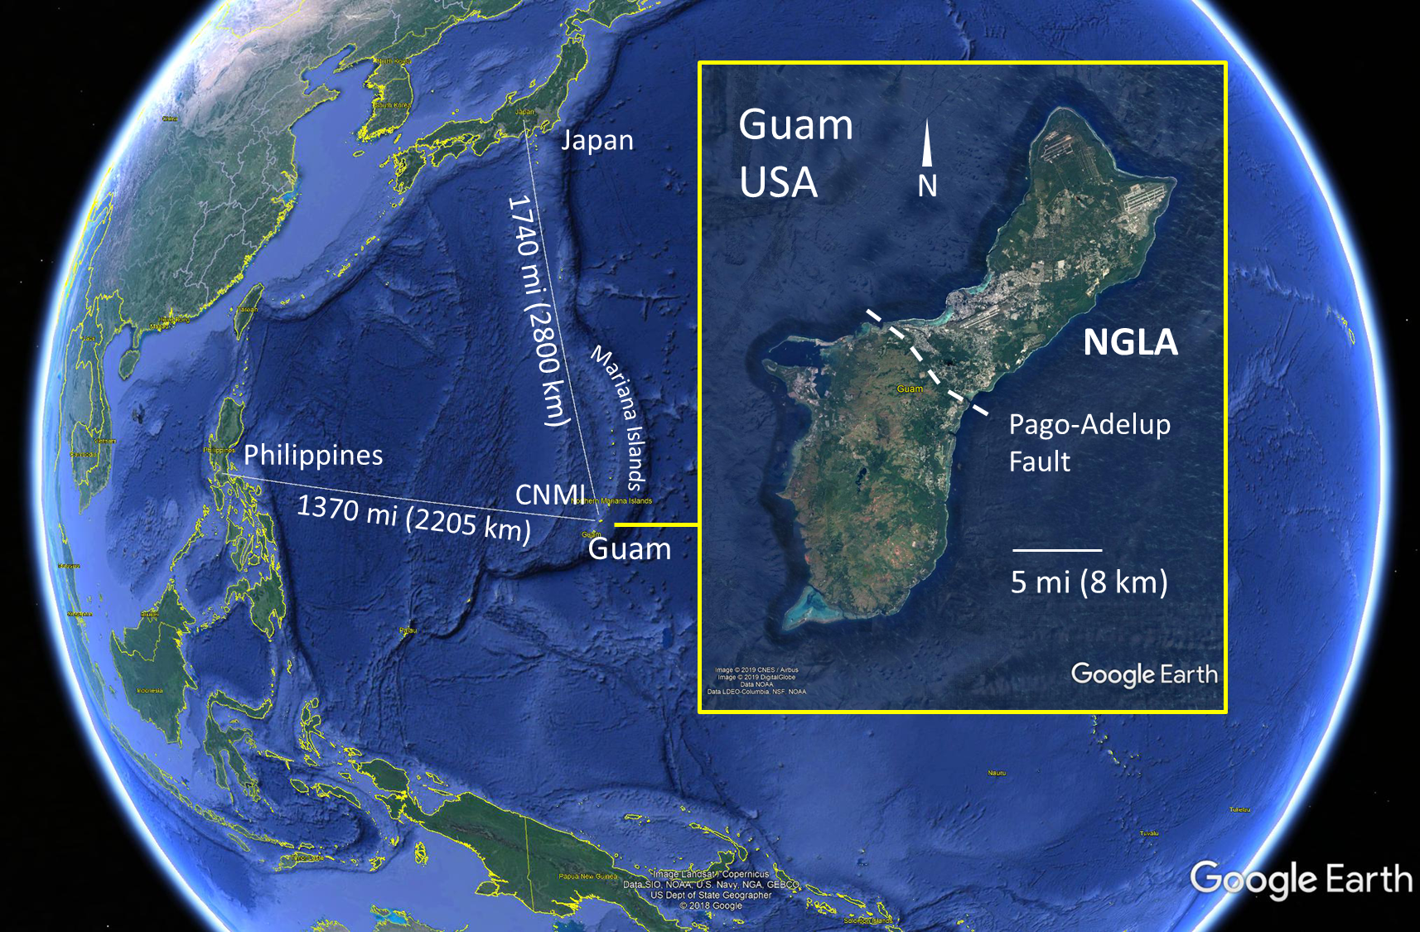
DOWLs
rain gage
20 MGD
76 m³/d
OWLs
Notes:
Guam is a small island 30 mi in length, in the western pacific, southern most and largest of the Mariana Island chain. A 4.5-hour flight to Incheon. (Click)
It has the Northern Guam Lens Aquifer that is an unconfined island karst aquifer, that supplies 90% of the island’s 45 mgd (171K cubic m/d) demand of utility water. It is divided into 6 management aquifer basin. The observation wells in the Yigo-Tumon Aquifer Basin in the Northern Guam Lens Aquifer (NGLA) was scoped to conduct an empirical hydrologic study that characterized the dynamic response of the lens to natural climate variations.
The goal was to characterize the response of the phreatic layers to natural, interannual and decadal-scale climate variations. The ultimate purpose (application) of the results will be to provide an empirical basis for determining appropriate sustainable management practices, given the hydrogeologic complexity of the aquifer and the natural environmental stresses on it.

Slide 7
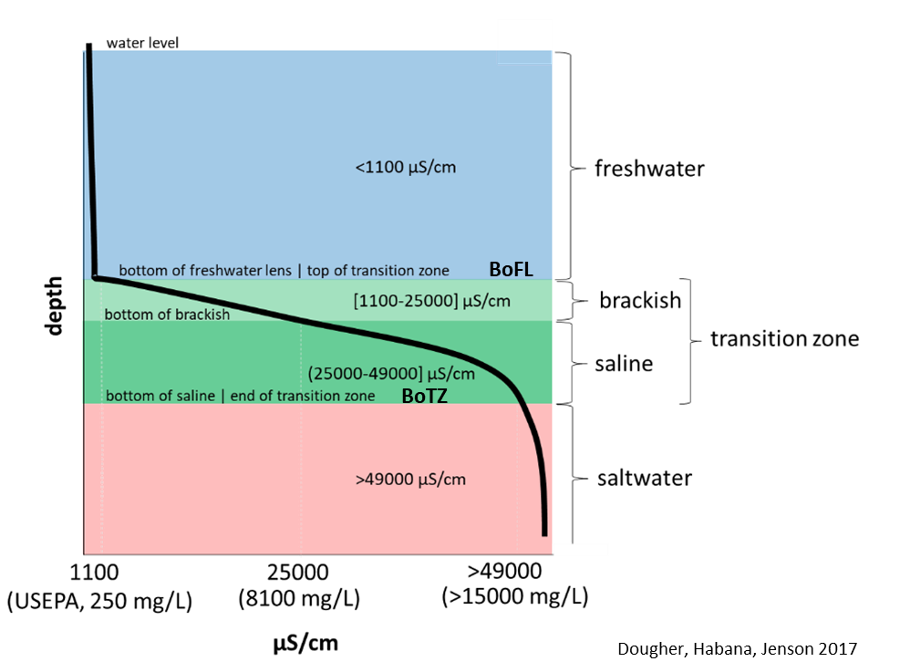
Notes:
Specific objectives were to define the anatomy as phreatic interfaces/layers, extract deep observation well data of phreatic interfaces and arrange data into a time-series as a hydrographic analysis aligned with potentially contributing hydrologic processes. Results showed the actual thickening and thinning of the lens in response to rainfall and drought.
This is the most comprehensive hydrographic analysis of the NGLA today, capitalizing on decades of data collection through the Guam Hydrologic Survey and Comprehensive Water Monitoring Program. The techniques here may be applicable for determining capacities in similar aquifers

Slide 8
Background
Yigo-Tumon Aquifer Basin
Basin Geology, Hydrology, Hydrogeology
Freshwater Lens Dynamics
CWMP and Observation Wells
Notes:
Now, some background…

Slide 9
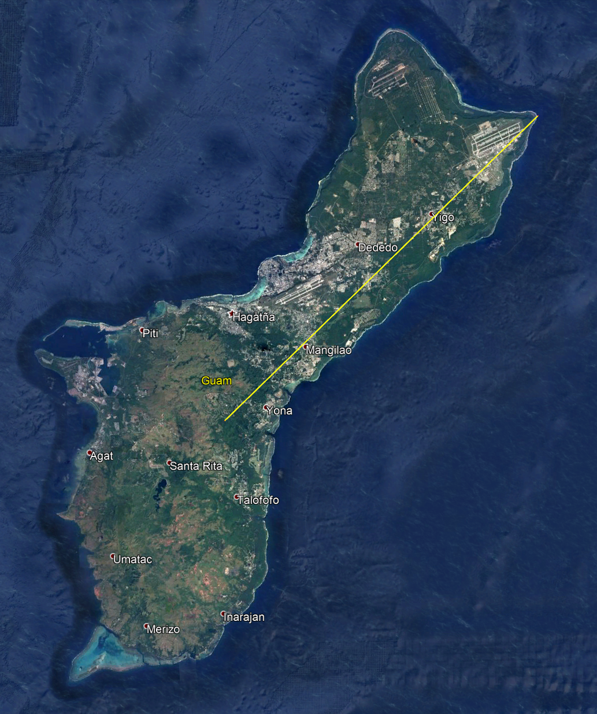
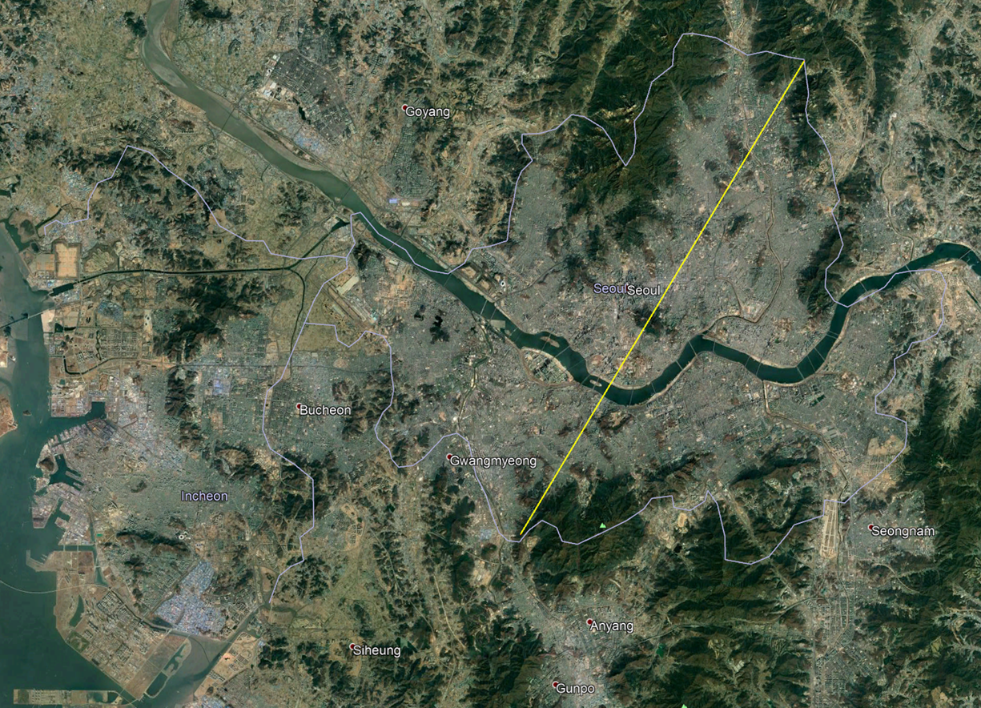
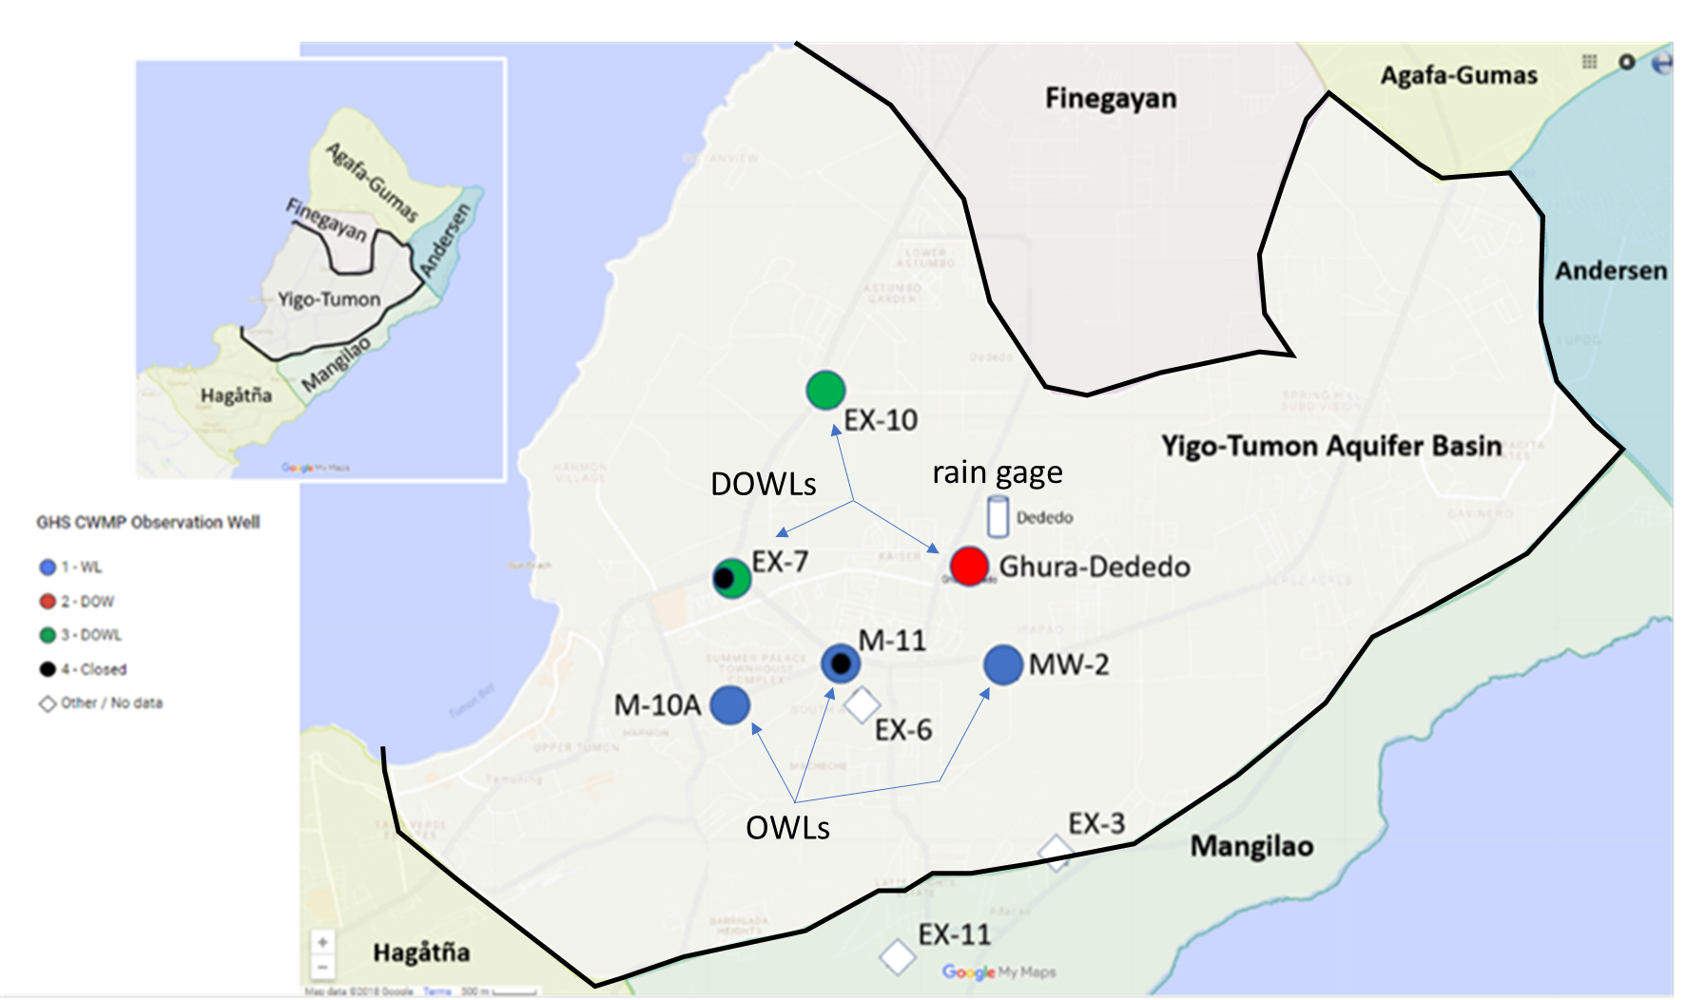
Guam, USA
Guam, USA
NGLA
20 mi / 32 km
20 mi / 32 km
Pago-Adelup Fault
Seoul,
South Korea
Notes:
Here’s Guam – The Northern Guam Lens Aquifer is a karstified limestone aquifer north of the Pago-Adelup Fault. South of that is composed of volcanic formations and a web of stream cut valleys and a reservoir. The yellow line is 32 km, to scale with the yellow line across Seoul, to the right.
The scope were observation wells in the NGLA’s Yigo-Tumon Aquifer Basin that has three deep observation wells (DOWs) that penetrate the freshwater lens into the saltwater beneath, and with water level (DOWLs): EX-7, GD (GHURA-Dededo), and EX-10. This study was limited to DOWLs, not observation water level (OWL) wells: M-10A, M-11, and MW-2. The delimitations are the DOWLs in the domain, available meteoric, tidal, and climate index. The variables of interest are water level, freshwater lens, transition zone thickness, and seasonal lens thickness dynamics

Slide 10
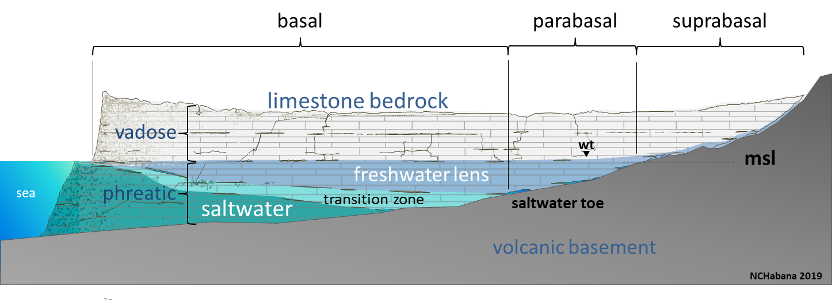
Notes:
Here’s the schematic diagram of the NGLA. It is formed of a highly porous limestone bedrock plateau atop a considerably impervious volcanic basement. Deep vadose (unsaturated zone) of some 60-180 m (200 – 600 ft) deep and a dynamic saturated/phreatic zone of a freshwater lens, transition zone, and saltwater. The deep observations wells are in the basal zone, that is bored through the freshwater and transition zone, and into the saltwater.

Slide 11
Notes:
You have salt water from the ocean that has made its way into this porous bedrock. Freshwater from rain works its way down the limestone pores to displace the saltwater beneath, accumulating forming a freshwater lens layer ontop of saltwater… You’ll notice, and it is often drawn that way, where the lens is thicker inland, and thins out to the coast – its called a lens aquifer because of the freshwater’s lenticular shape. Of course, in reality, however, the shape of the freshwater may not be as smooth as we’ve drawn it to be in this schematic…

Slide 12
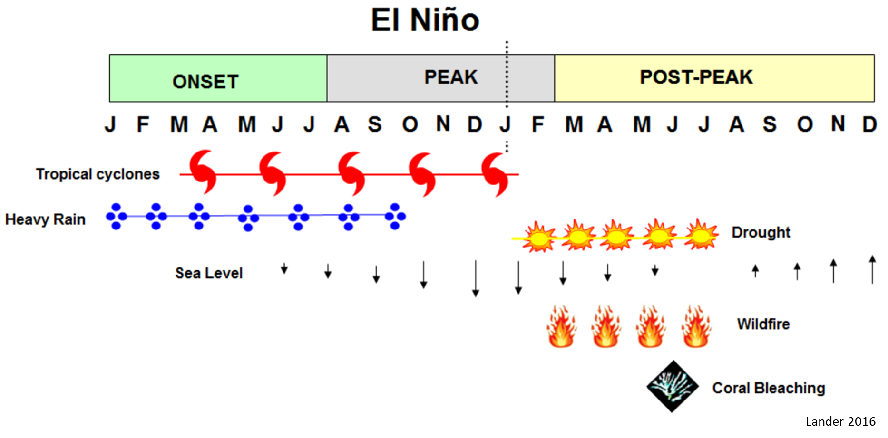
Notes:
On average, Guam has a dry and wet season, January-June and July to December. It receives 100 inches, 254 cm, of rainfall. During El Nino, there is a deviation from the average seasonal pattern. Particularly, more storms including tropical cyclones – which means lots of aquifer recharge. Followed by a prolonged drought that bring on hazards of wildfire and coral bleaching in the post peak. Many pacific islands in the western pacific suffer a thinning of the lens during drought, bringing the saltwater up and drawn in production wells.
Lens thickening or thinning is a result of recharge, from seasonal rainfall or drought. Rainfall and drought may deviate from average seasonal cycle, interannually, as a result of the effects of El Nino Southern Oscillation on the western pacific islands. Sea level affects lens position, and low tides bring the lens position down, also affected by El Nino shifting following trends with Tradewinds, lowest with strong westerlies. Decadal drought is possibly due to Pacific Decadal Oscillation, according to our co-author meteorologist, Mark Lander.

Slide 13
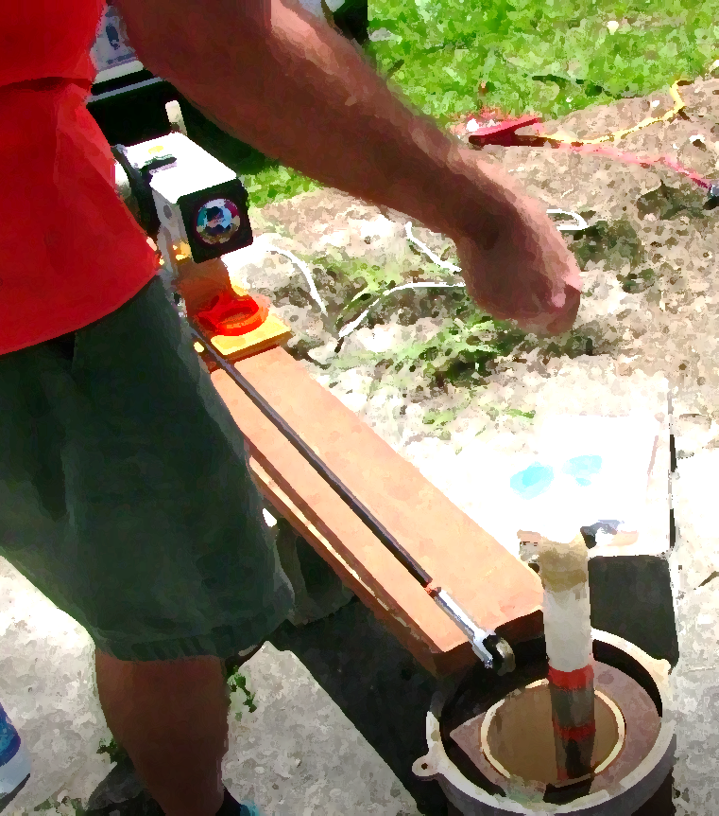
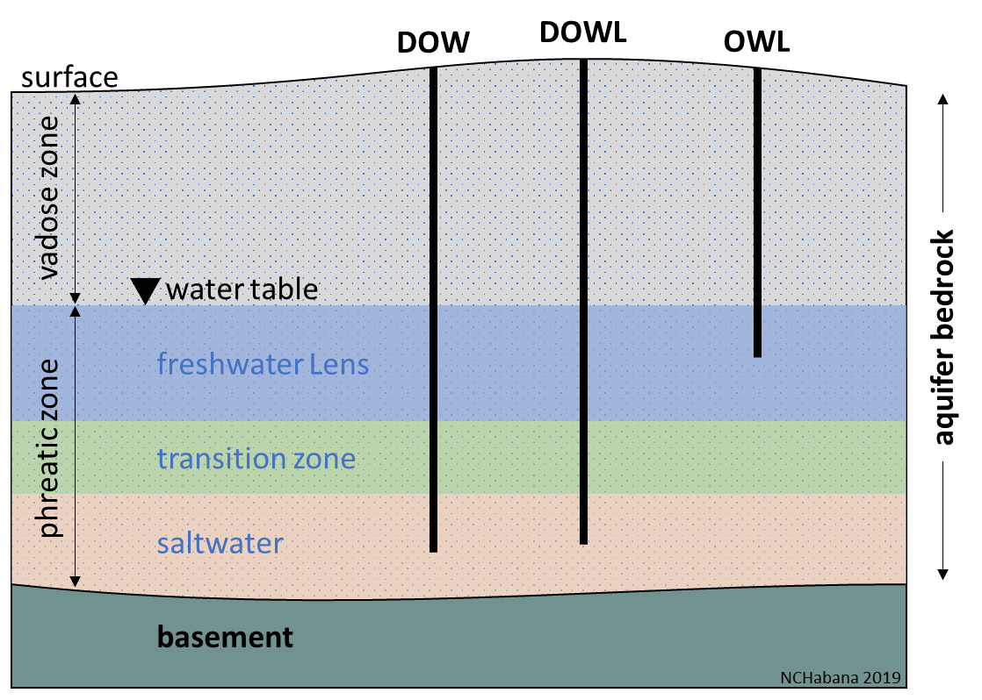
USGS’ Pacific Island Water Science Center collecting data quarterly – annually, through the Comprehensive Water Management Program (Guam P.L. 24-161) administered by Water and Environmental Research Institute of the Western Pacific, University of Guam.
Notes:
Observation well data: We have three kinds of observation wells on Guam, DOW – deep observation wells, OWL – observation water level only or hydraulic head, and both DOW and OWL together called DOWL. OWLs use pressure loggers (or transducers) to log water level, while, DOWs measure conductivity, temperature, and depth, or CTD, that translates into chloride and salinity as the probe is lowered into the DOW.

Slide 14
Methods
Data Sources
Anatomy of Aquifer
Analysis
Notes:
The methods

Slide 15
Data Sources
Observation | URL link
EX-7 | http://waterdata.usgs.gov/nwis/inventory?agency_code=USGS&site_no=133119144491771
EX-10 | http://waterdata.usgs.gov/nwis/inventory?agency_code=USGS&site_no=133224144495271
GHURA-Dededo | http://waterdata.usgs.gov/nwis/inventory?agency_code=USGS&site_no=133120144505471
M-10A | http://waterdata.usgs.gov/nwis/inventory?agency_code=USGS&site_no=133032144491871
M-11 | http://waterdata.usgs.gov/nwis/inventory?agency_code=USGS&site_no=133047144500171
Rainfall | https://www7.ncdc.noaa.gov/CDO/cdoselect.cmd?datasetabbv=GSOD&resolution=40
ONI | http://www.cpc.ncep.noaa.gov/products/precip/CWlink/MJO/enso.shtml
Sea level | https://www.ngdc.noaa.gov
SST | https://www.ngdc.noaa.gov
DOWLs
DOWs
OWLs
National Climatic
Data Center
Contributing
Hydrologic Processes
Oceanic Nino Index
Apra Harbor, Guam
Sea Surface Temperature
guamhydrologicsurvey.uog.edu
Notes:
Our data sources are available online, accessible in our guamhydrologicsurvey website, and here listed available from the US national databases.

Slide 16
Anatomy of the Lens Aquifer
Glossary of Hydrology
Notes:
Profile description was defined, for freshwater, transition zone, and saltwater. Actual CTD data show how concentration increases with depth, rapidly at the transition zone. The transition zone was split between, near the 50% isochlor, into brackish and saline. Freshwater is defined from USEPA’s 250 mg/L limit. Data values from interfaces were extracted and graphed in a time series.

Slide 17
Analysis
Notes:
We used Microsoft Excel to organize our data and perform hydrologic and statistical analysis. The results are a freshwater lens hydrograph aligned with contributing hydrologic processes, we also refer to as the multi-variable time-series/hydrographic analysis. And, a vertical frequency analysis for each DOW.

Slide 18
Results and Discussion
Contributing Hydrologic Processes and lens hydrograph
Vertical frequency analysis
Discussion

Slide 19
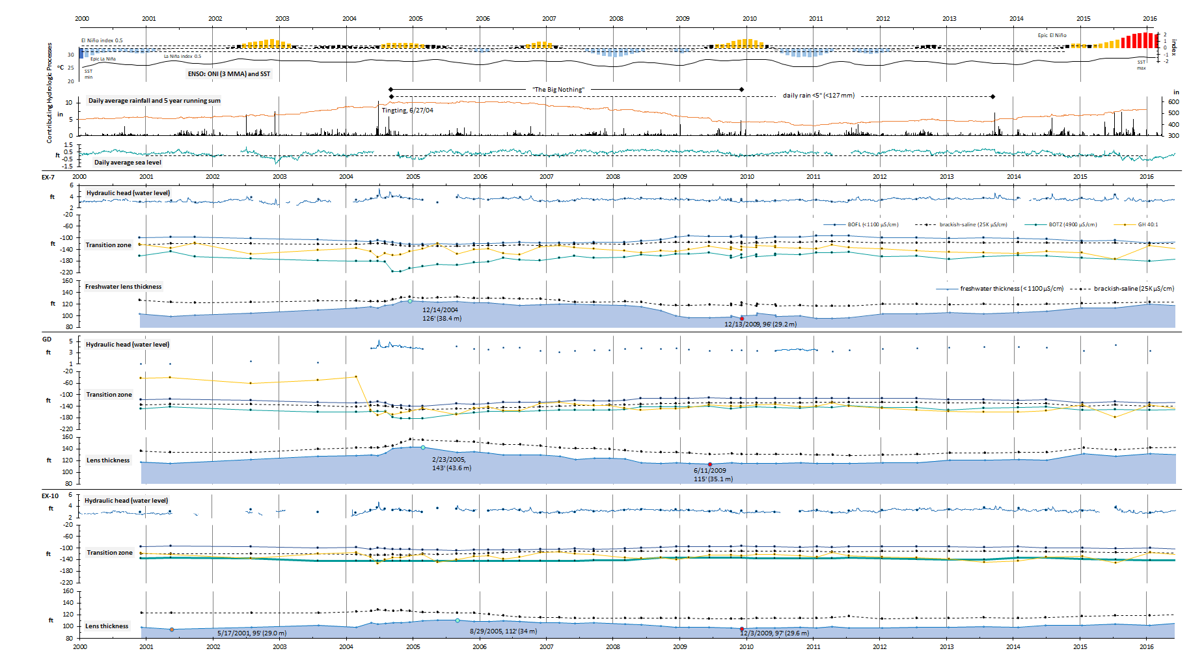
1 in = 2.54 cm, 1 ft = 30.48 cm
Notes:
Here it is, lens hydrograph and contributing hydrologic processes analysis, squished into a slide.
First the map… DOWLs EX-7, EX-10, GD... Hydraulic head,
Contributing hydrologic processes, top ONI and SST, Rainfall, daily average sea level

Slide 20
1 in = 2.54 cm, 1 ft = 30.48 cm

Slide 21

Conclusion
Major storms thicken the aquifer
Storms recharge quickly, drains slowly
< 4” daily rain through out years results in thinning
> 5” daily rain in the years, moves into thickening

Slide 22


Questions?

