Slide 1
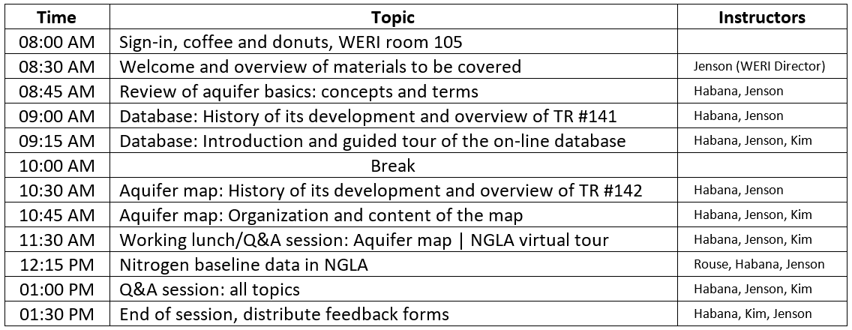

Slide 2
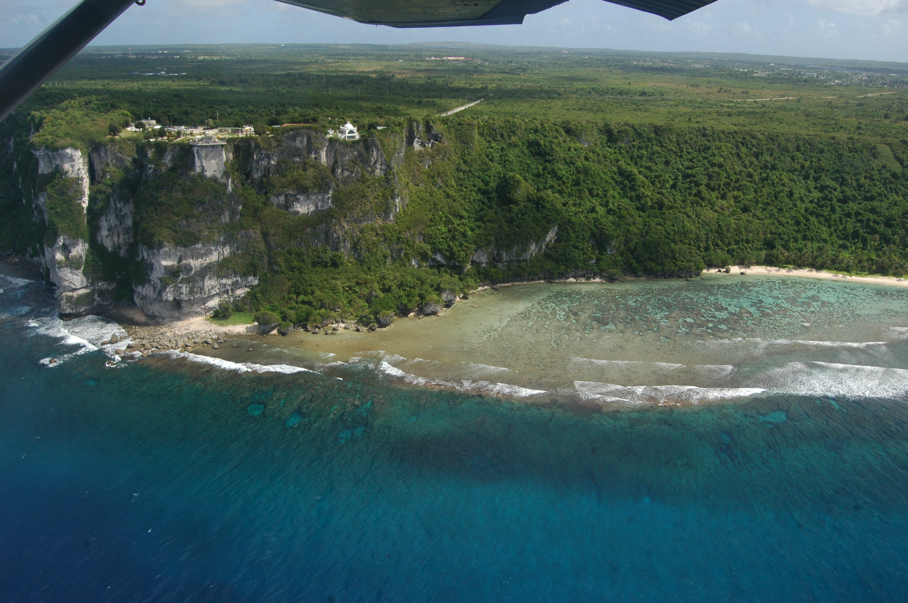

The Northern Guam
Lens Aquifer
Concepts and Terms
Professional Workshop Series
Workshop #1: September 11, 2016
Water & Environmental Research Institute of the Western Pacific
University of Guam

Slide 3
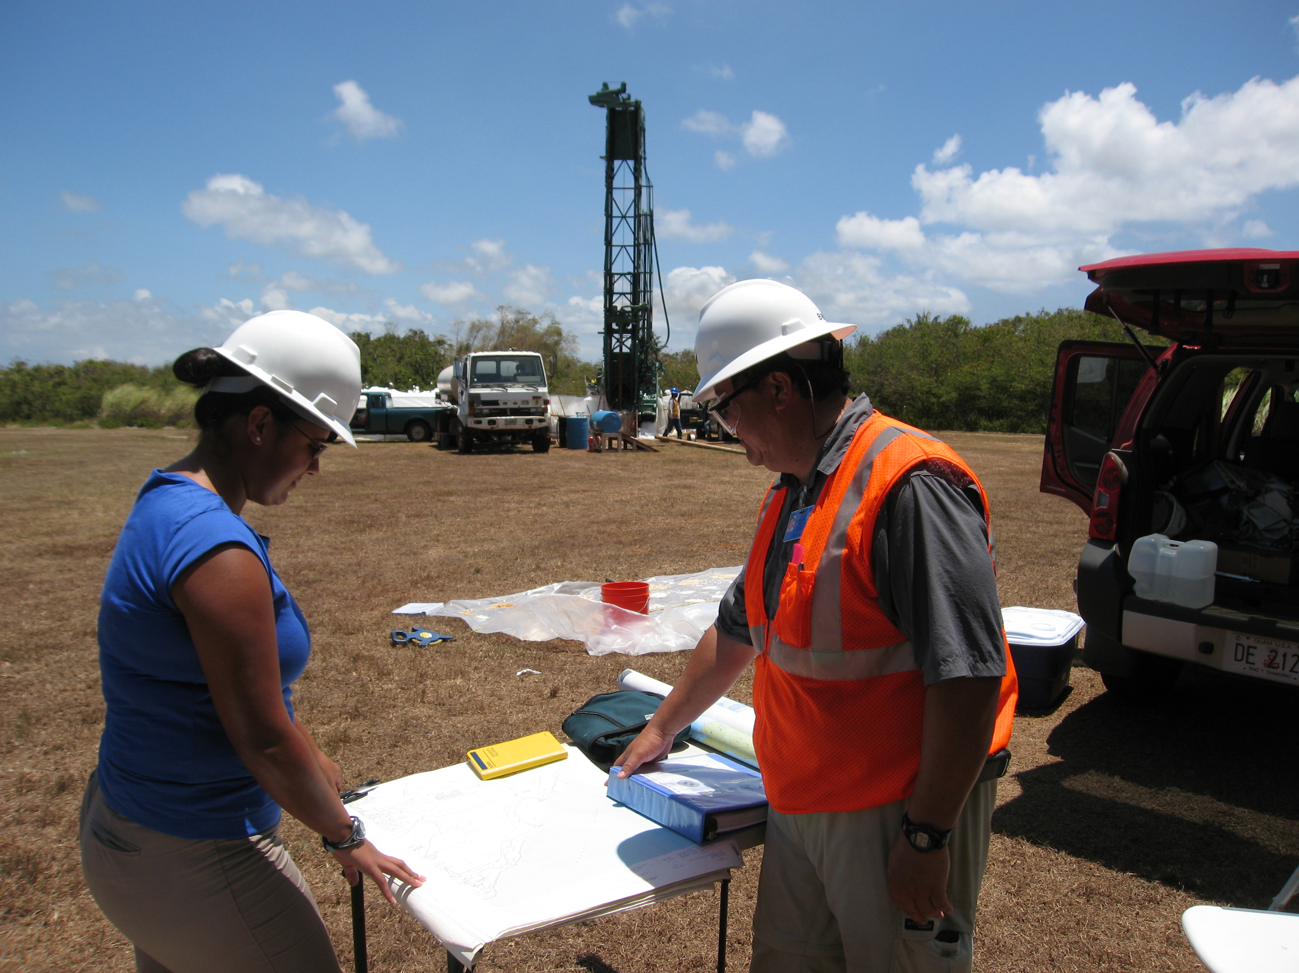
Overview
3 geologic units
6 aquifer basins
3 groundwater zones
5 groundwater salinity benchmarks
Current configuration and conditions

Slide 4
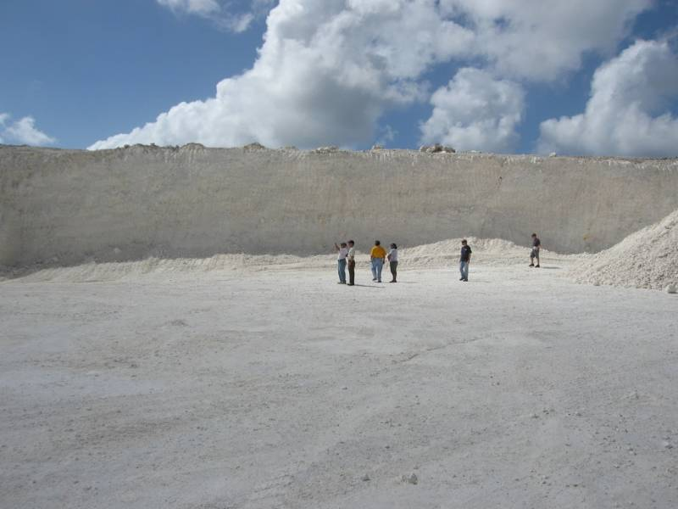
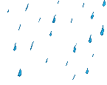
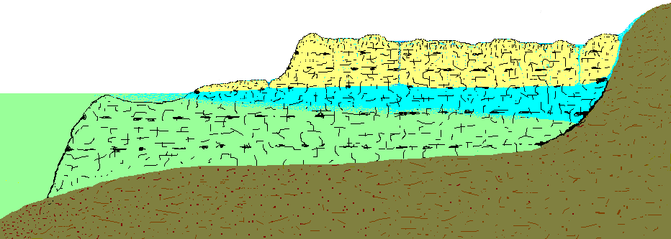
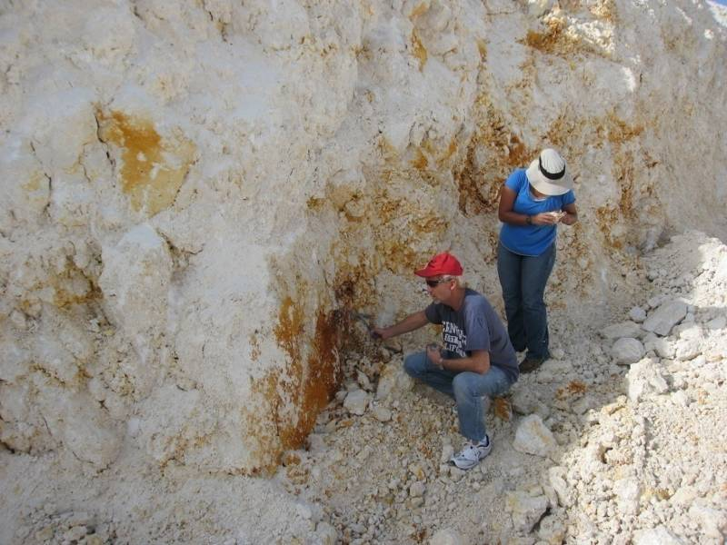
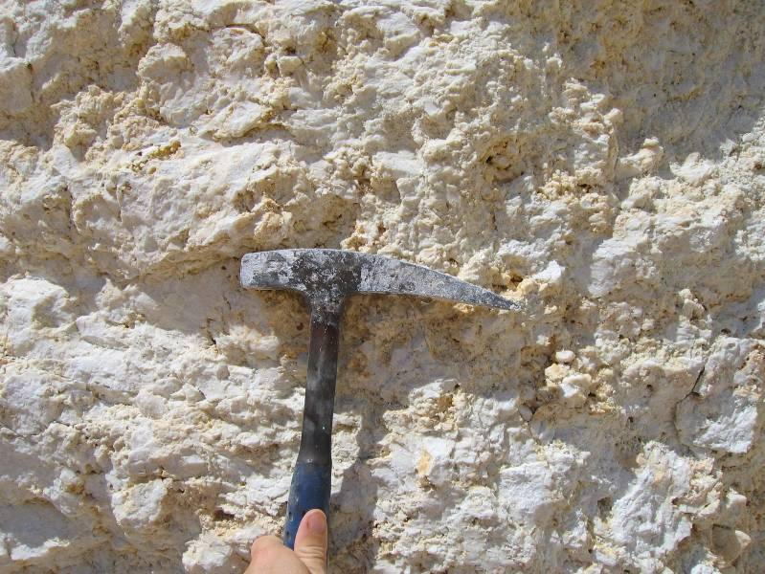
Northern Guam Lens Aquifer
Barrigada Limestone
Ave. rainfall = 100 in/yr
Core of the aquifer
Local hydraulic conductivities = 0 to 5,000 ft/day
conduit flow
ponding water
infiltrating water
fast flow
discharging fresh water
percolation
Cemented zones
fresh water lens
Porosities = 0 to 25%
former sea level
limestone bedrock
Barrigada LS
sea water
Porous zones
volcanic basement
Notes:
[Click: rainfall amount]
Mean annual rainfall is about 100 inches, or 2.4 meters.
[Click: Barrigada LS]
The core of the aquifer is composed of the Barrigada Limestone, a foraminiferal detrital limestone that varies from chalky, porous, and friable, to massive, cemented, and hard.
[Click: Marianna LS]
It is surrounded and covered by fossil fringing reef and lagoonal deposits mapped as the Marianna Limestone.
[Click: Water-table caves]
Both units contain networks of caves formed at the water table during the present and past sea-level still-stands.
[Click: Alutom Formation]
The ridges and valleys of the essentially impermeable volcanic Alutom Formation, partition the bedrock aquifer into separate sub-basins.
[Click: Insurgence]
Waters flowing along the contact between the two units have formed networks of conduits that occupy both the modern vadose and phreatic zones.

Slide 5
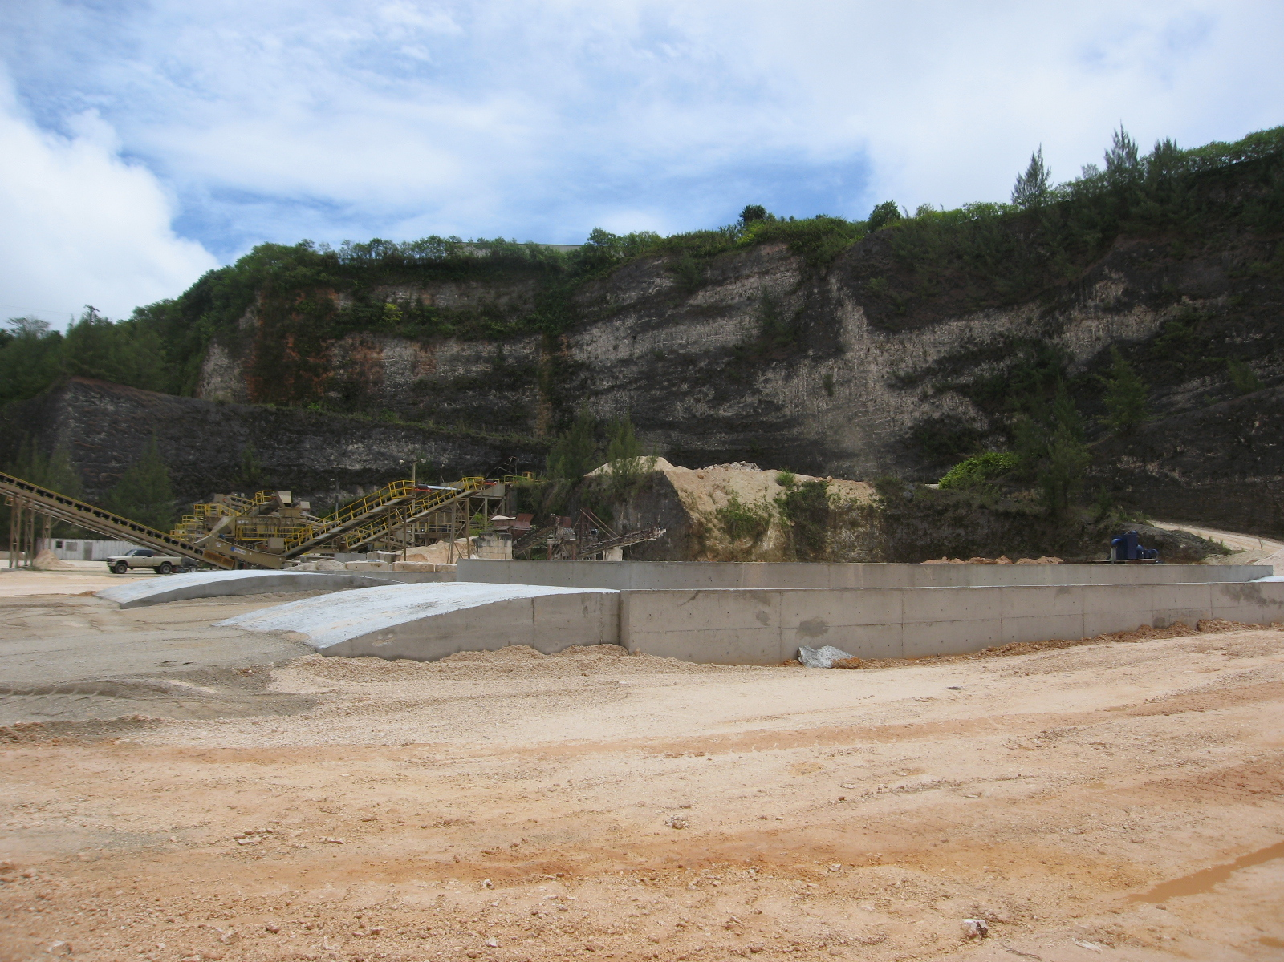
Northern Guam Lens Aquifer
Faults and fractures make large-scale flow routes
ponding water
infiltrating water
conduit flow
fast flow
discharging fresh water
percolation
fresh water lens
former sea level
limestone bedrock
Barrigada LS
Regional hydraulic conductivities very high: up to 90,000 ft/day)
sea water
volcanic basement
Notes:
[Click: rainfall amount]
Mean annual rainfall is about 100 inches, or 2.4 meters.
[Click: Barrigada LS]
The core of the aquifer is composed of the Barrigada Limestone, a foraminiferal detrital limestone that varies from chalky, porous, and friable, to massive, cemented, and hard.
[Click: Marianna LS]
It is surrounded and covered by fossil fringing reef and lagoonal deposits mapped as the Marianna Limestone.
[Click: Water-table caves]
Both units contain networks of caves formed at the water table during the present and past sea-level still-stands.
[Click: Alutom Formation]
The ridges and valleys of the essentially impermeable volcanic Alutom Formation, partition the bedrock aquifer into separate sub-basins.
[Click: Insurgence]
Waters flowing along the contact between the two units have formed networks of conduits that occupy both the modern vadose and phreatic zones.

Slide 6
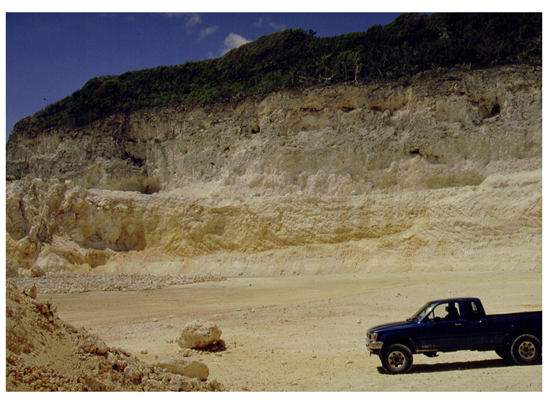

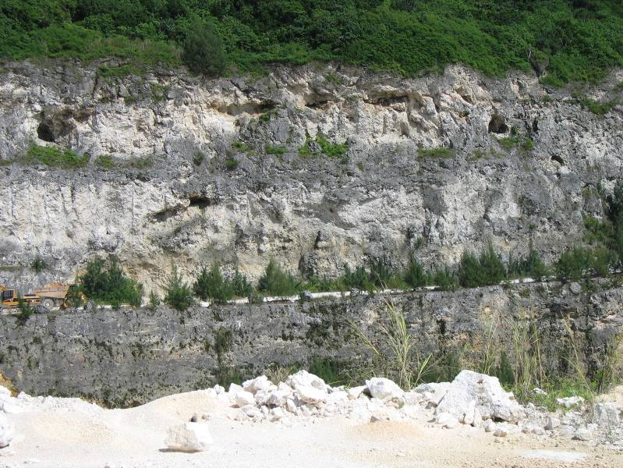
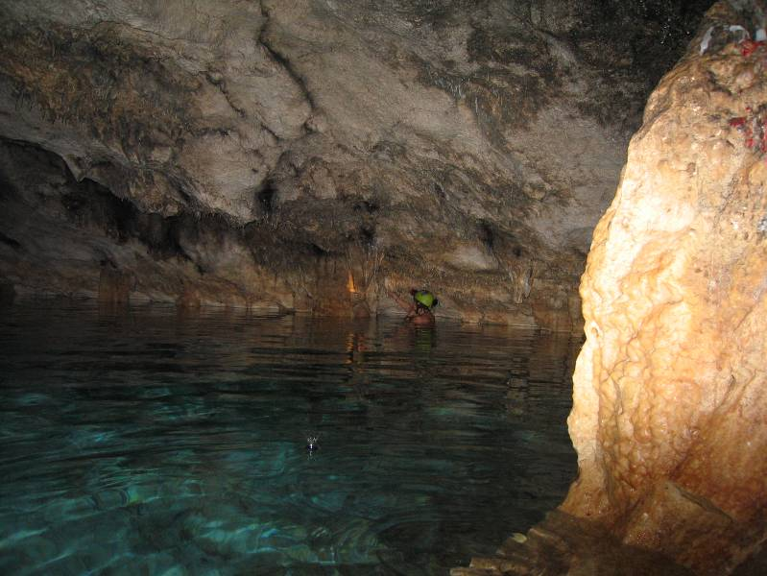
Mariana Limestone
Northern Guam Lens Aquifer
Water-table cave
Paget Cave
cave horizon (paleo-sea level)
Rim and surface of the aquifer
ponding water
infiltrating water
conduit flow
fast flow
discharging fresh water
percolation
fresh water lens
former sea level
Mariana LS
limestone bedrock
Barrigada LS
sea water
volcanic basement
Notes:
[Click: rainfall amount]
Mean annual rainfall is about 100 inches, or 2.4 meters.
[Click: Barrigada LS]
The core of the aquifer is composed of the Barrigada Limestone, a foraminiferal detrital limestone that varies from chalky, porous, and friable, to massive, cemented, and hard.
[Click: Marianna LS]
It is surrounded and covered by fossil fringing reef and lagoonal deposits mapped as the Marianna Limestone.
[Click: Water-table caves]
Both units contain networks of caves formed at the water table during the present and past sea-level still-stands.
[Click: Alutom Formation]
The ridges and valleys of the essentially impermeable volcanic Alutom Formation, partition the bedrock aquifer into separate sub-basins.
[Click: Insurgence]
Waters flowing along the contact between the two units have formed networks of conduits that occupy both the modern vadose and phreatic zones.

Slide 7
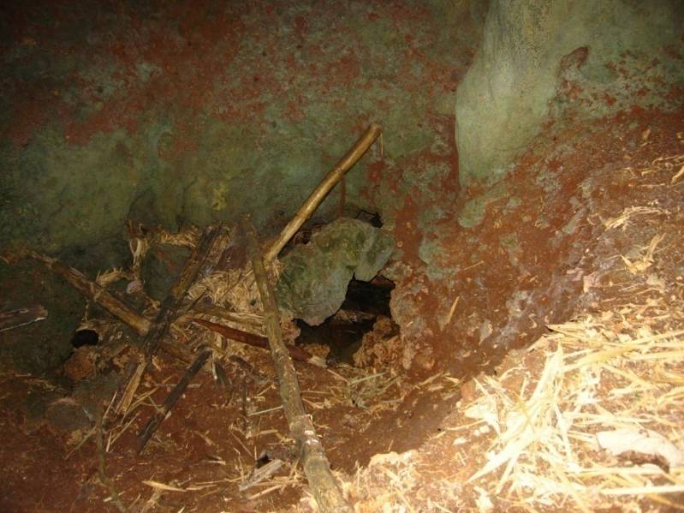
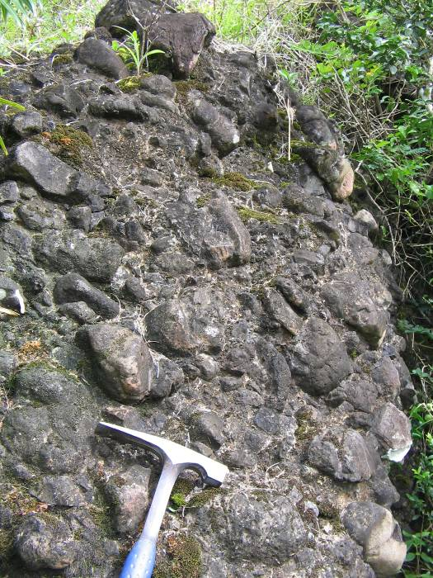
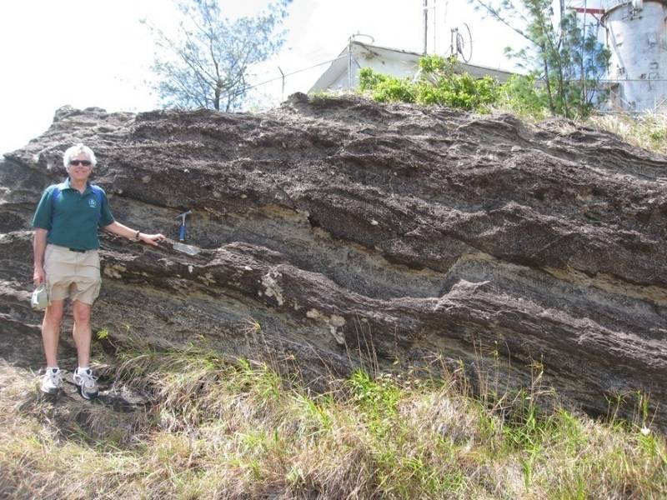
Northern Guam Lens Aquifer
Sinkhole swallow holes
limestone
~1.5 ft dia,
Alutom Formation
ponding water
infiltrating water
conduit flow
fast flow
discharging fresh water
percolation
Mt Santa Rosa, Mataguac Hill
fresh water lens
former sea level
Mariana LS
limestone bedrock
Barrigada LS
Base and topographic partition of the aquifer
sea water
Aquiclude
(practically impermeable)
volcanic basement
Alutom Formation
Notes:
[Click: rainfall amount]
Mean annual rainfall is about 100 inches, or 2.4 meters.
[Click: Barrigada LS]
The core of the aquifer is composed of the Barrigada Limestone, a foraminiferal detrital limestone that varies from chalky, porous, and friable, to massive, cemented, and hard.
[Click: Marianna LS]
It is surrounded and covered by fossil fringing reef and lagoonal deposits mapped as the Marianna Limestone.
[Click: Water-table caves]
Both units contain networks of caves formed at the water table during the present and past sea-level still-stands.
[Click: Alutom Formation]
The ridges and valleys of the essentially impermeable volcanic Alutom Formation, partition the bedrock aquifer into separate sub-basins.
[Click: Insurgence]
Waters flowing along the contact between the two units have formed networks of conduits that occupy both the modern vadose and phreatic zones.

Slide 8

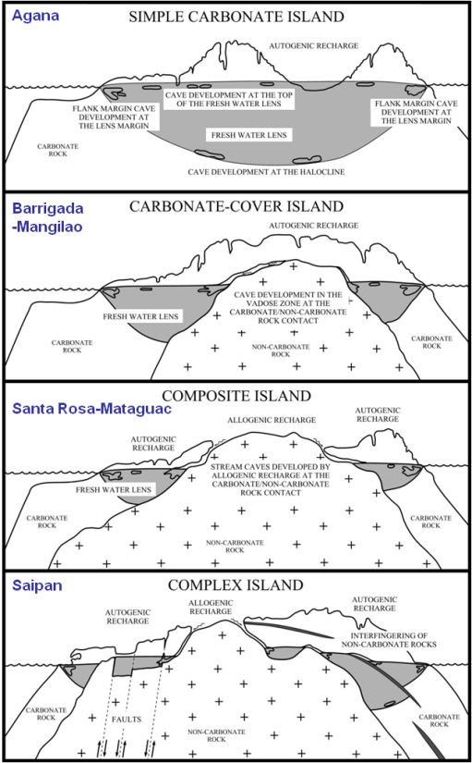
Groundwater Basins
WERI
Lens-Basement-Sea Level
Relationship
Basement partitions
aquifer into 6 basins
Agafa Gumas
Lens above basement
Finegayan
Andersen
Basement above lens
Yigo-Tumon
Basement at surface
Hagåtña
Complex rock units
Mangilao
Sea-level contour
Contour interval 20 m
Notes:
The Northern Guam Lens Aquifer is partitioned into six groundwater basins by hills and valleys in the underlying volcanic basement rock, which is much less permeable than the limestone bedrock above it.

Slide 9
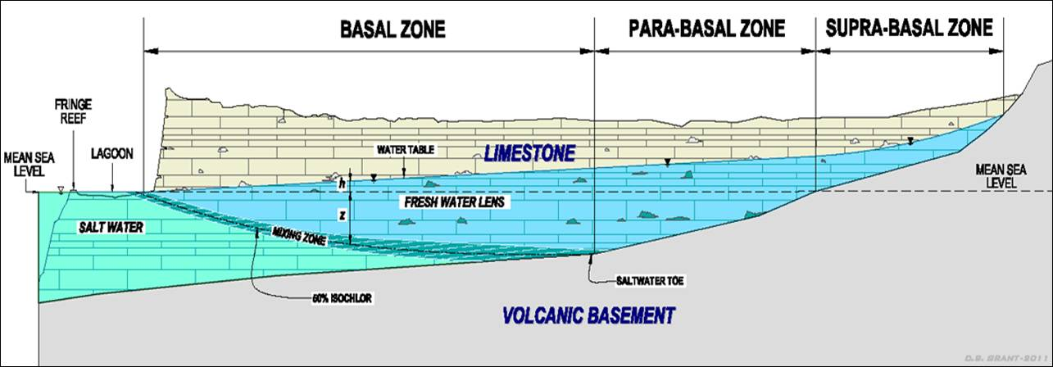
Groundwater Zones
NAVFAC Final Report Apr 2010 Guam Water Well Testing
Roff, Jenson & Schuman
Supra-basal water: underlain by basement rock and stands above sea level
  Invulnerable to sea water contamination
  Very high quality water—headwaters of the catchment
  Most responsive to wet-dry cycles
  Very hard to find (even with a map; occurs in patches)
Para-basal water: underlain by volcanic basement
  Not susceptible to contamination by sea water
  High quality—”upstream” from surface threats
  More rapidly affected by wet-dry cycles than basal water
  Hard to find (without an accurate map)
Basal water: underlain sea water
  Vulnerable to contamination by underlying sea water
  “Downstream” from surface contaminant sources
  Really easy to find
Notes:
[Click] Groundwater descends from the supra-basal zone to the basal zone, capturing downward-percolating recharge along its whole length, like a big conveyor belt.
[Click] The lowest grade water is the basal water, for which the grade deteriorates with depth.
[Click] Much higher grade is the para-basal water, which is harder to find, but worth the cost.
[Click] The highest grade is supra-basal water—which is very hard to locate at its source, but can be intercepted downstream by wells in the para-basal zone.

Slide 10
Groundwater Quality
Chloride Benchmarks
parabasal
water
basal water
limestone aquifer
sea level
water table
< 150
< 70
< 30
150 to 250
CDM (Mink), 1982
McDonald & Jenson, 2003
> 250
mixing zone
Saltwater
19,000
saltwater
toe
volcanic basement
parabasal range < 30 mg/l
saltwater toe range > 30 to 70 mg/l
basal range > 70 to < 150 mg/l
saltwater intrusion > 150 mg/l
USEPA standard 250 mg/l
Notes:
For this study, as for previous ones, we adopted the water quality benchmarks first proposed by John Mink for the 1982 Northern Guam Lens Study—which is still the point of departure for groundwater evaluations on Guam.
The regulatory “cutoff” on Guam, at least for now, is the USEPA secondary standard of 250 ppm chloride. WHO guidelines suggest that up to 600 ppm chloride can still be regarded as potable, however….
In 1982, Mink advised that the engineering “target” for water quality at each well be 150 ppm chloride.

Slide 11
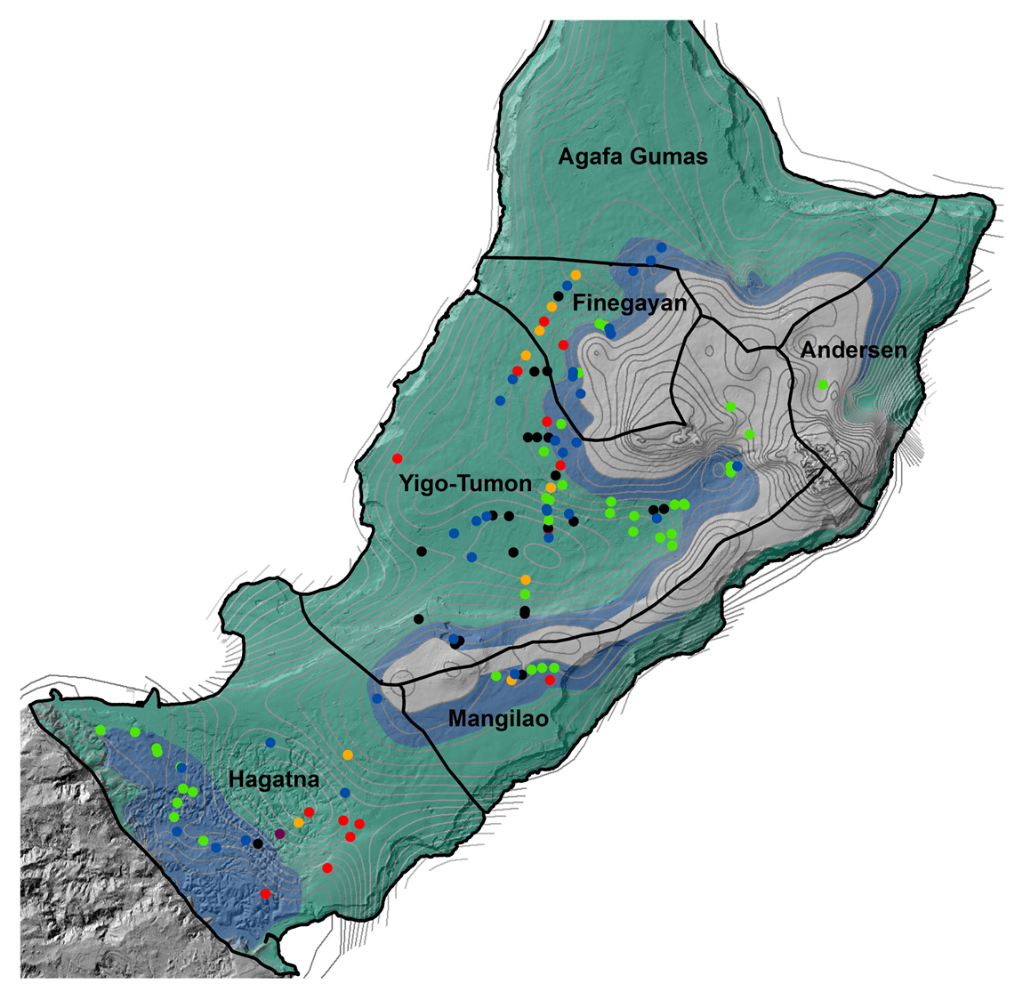
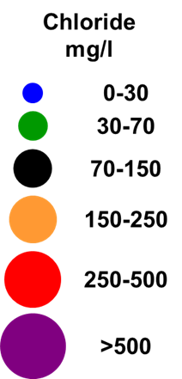
Northern Guam Lens Aquifer
Area: 264 sq. km (95 sq. mi.)
Active wells: ~100
Six groundwater basins
  Yigo-Tumon: 30%
  Agafa Gumas: 23%
  Hagåtña: 22%
  Mangilao: 10%
  Andersen: 8%
  Finegayan: 7%
Three groundwater zones
  Basal: 70%
  Para-basal: 5%
  Supra-basal: 20%
Recharge
  255 MGD
    65″/yr
  200 MGD
    51″/yr
20%
70%
5%
Notes:
The Northern Guam Lens Aquifer has six groundwater basins, analogous to separate watersheds in a surface system.
Within each basin are three zones: the basal zone, which occupies 70% of the aquifer, the para-basal zone, which occupies only 5%, and the supra-basal zone, which occupies 20%.
How much recharge we get is a matter of active research—but the work to date puts it somewhere between 200 and 255 MGD.
Shown here is the current system, and the water quality of each production well, in terms of ppm Chloride.

