Slide 1
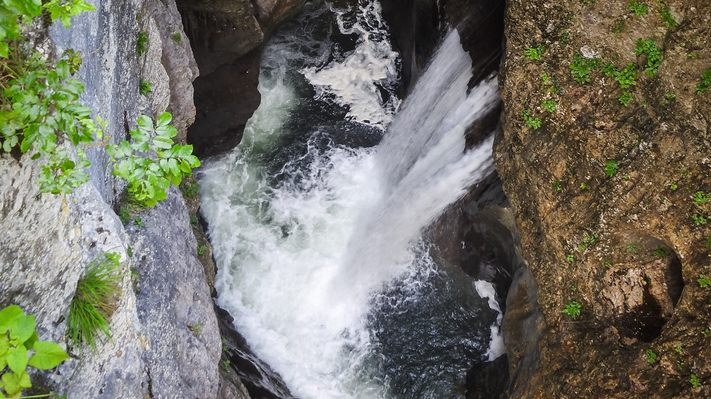
Karst Hydrogeology Global Trends in Instrumentation, Monitoring and Flow Modeling
(LEARNINGS FROM THE 27th international Karstological school)
Seminar 1: THURSDAY JuLY 25, 2019

Slide 2
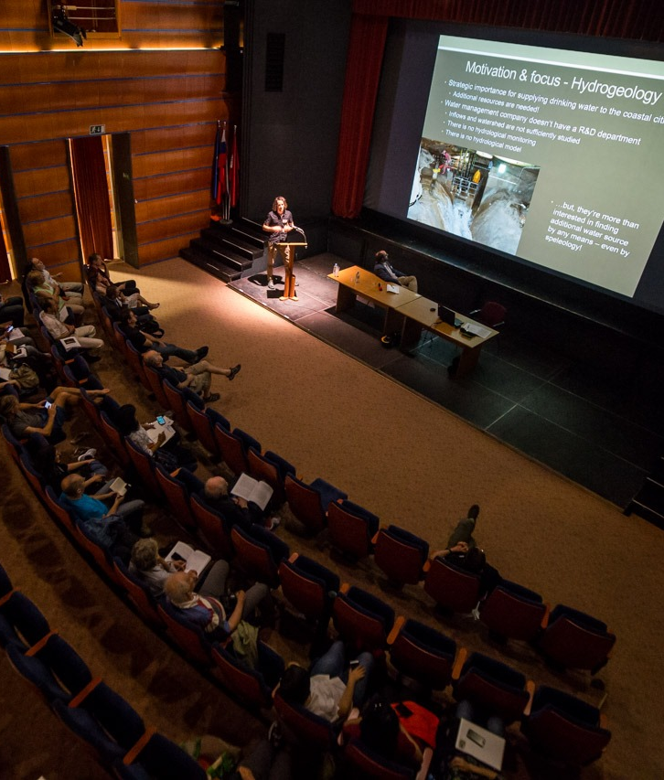
SESSION 1: KARST HYDROGEOLOGY – PAST, PRESENT AND FUTURE
Invited Lecture:
Karst Hydrogeology–Who, What, Why, Where, When & How (I. Sasowsky)
Structural control on water circulation in the Bossea karst system – Piedmont Italy
(A. Nannoni)
Comprehensive hydraulic and hydrochemical interpretation of a karst area in South Hungary
(K. Csondor)
The Châtaigniers cave (Ardèche, France): an indicator of Pleistocene variations and Combe d’Arc meander shortcut
(K. Genuite)
Karst Hydrogeology: The high-flow low-storage extreme in marble aquifers
(T. Faulkner)
Basin-scale conceptual groundwater flow model for carbonate regions
(A. Tóth)
Photo by: IKS ZASU

Slide 3
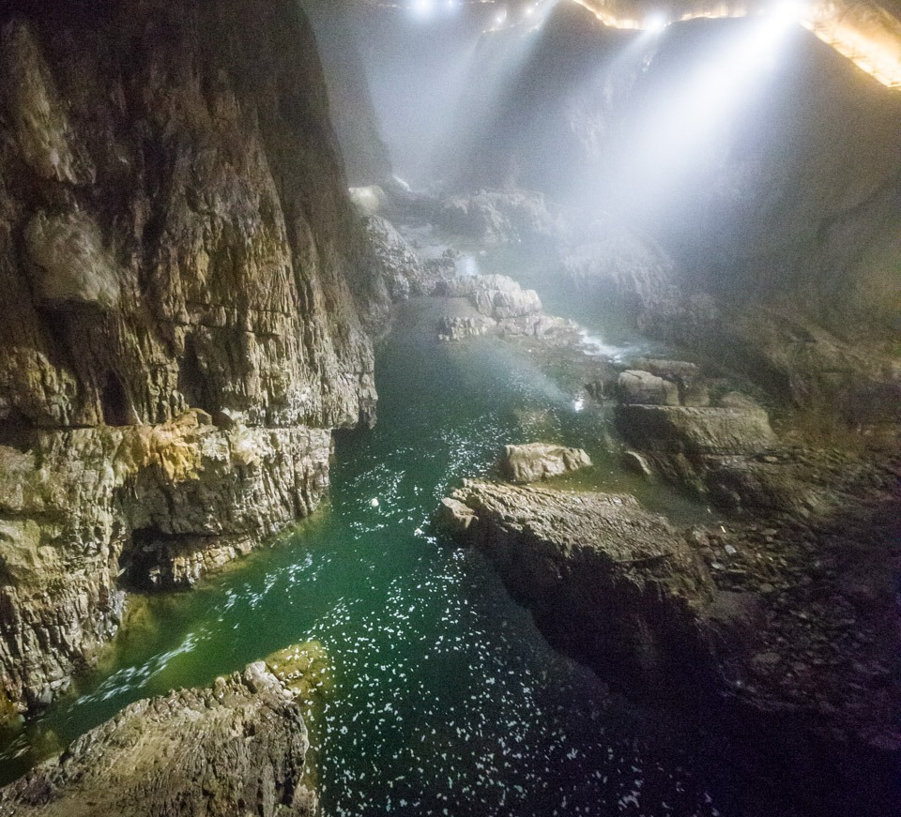
Karst Hydrogeology
Who, What, Why, Where, When and How
(I. Sasowsky)
Photo by: IKS ZASU

Slide 4
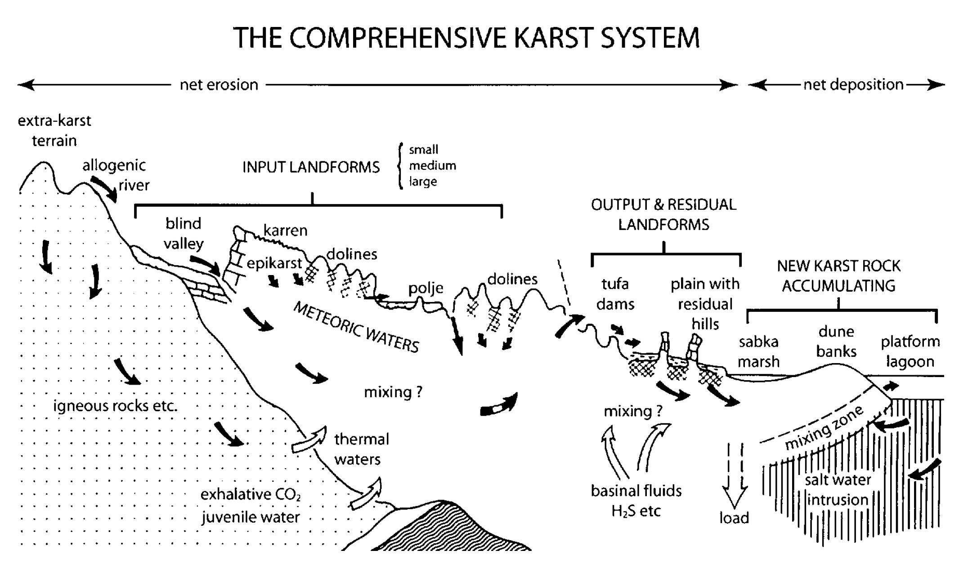
WHAT is a KARST HYDROGEOLOGICAL SYSTEM?
(Ford&Williams, 2007)
Karst Hydrogeology – Who, What, Why, Where, When and How (I. Sasowsky)

Slide 5
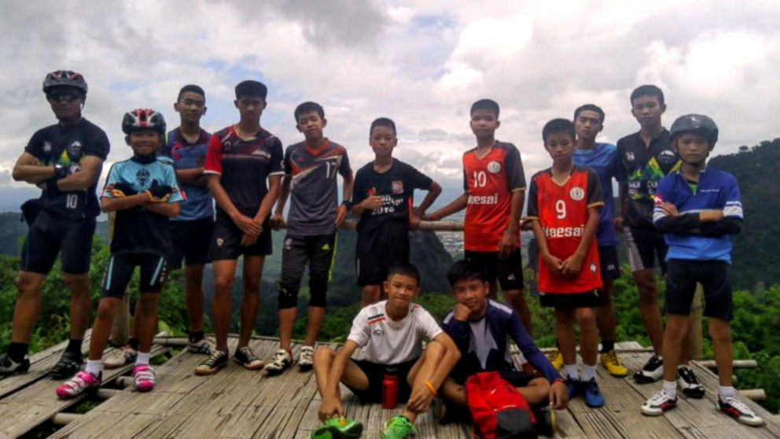
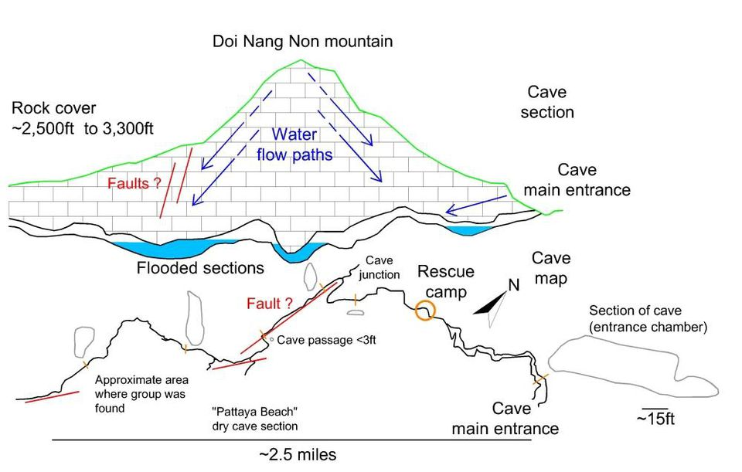
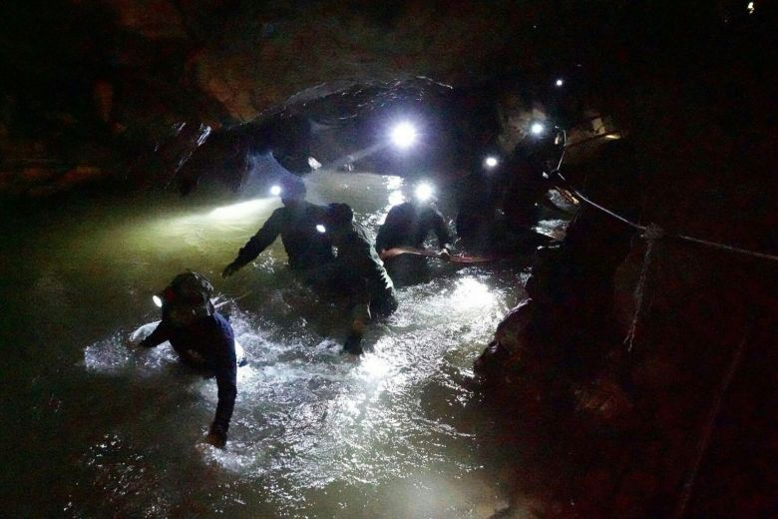
WHAT is a KARST HYDROGEOLOGICAL SYSTEM?
EXTREME FLOW VARIABILITY!
http://tiny.cc/5fo99y
http://tiny.cc/38m19y
Karst Hydrogeology – Who, What, Why, Where, When and How (I. Sasowsky)

Slide 6
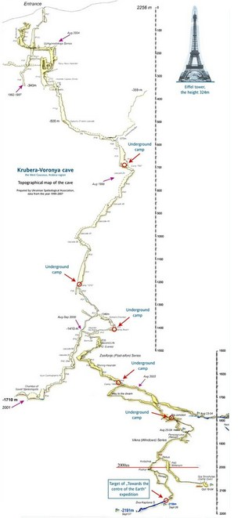
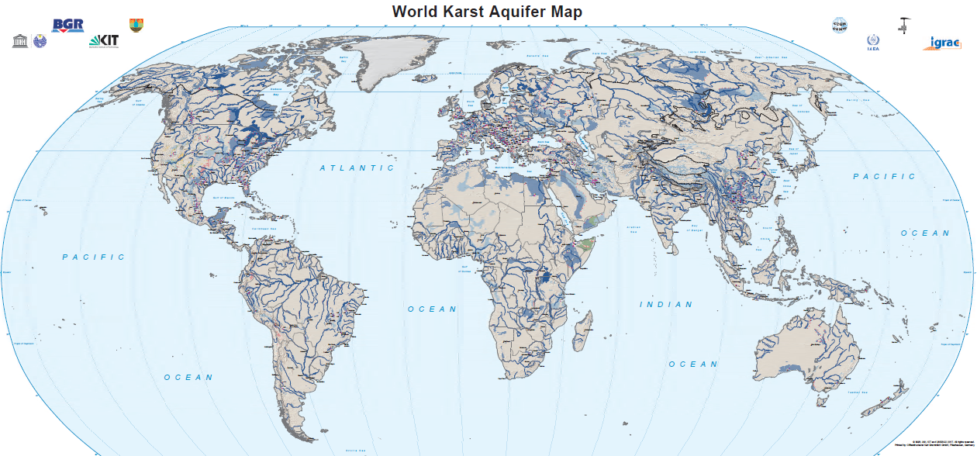
WHERE IS IT OCCURING?
http://tiny.cc/ulo99y
https://www.un-igrac.org
Karst Hydrogeology – Who, What, Why, Where, When and How (I. Sasowsky)

Slide 7
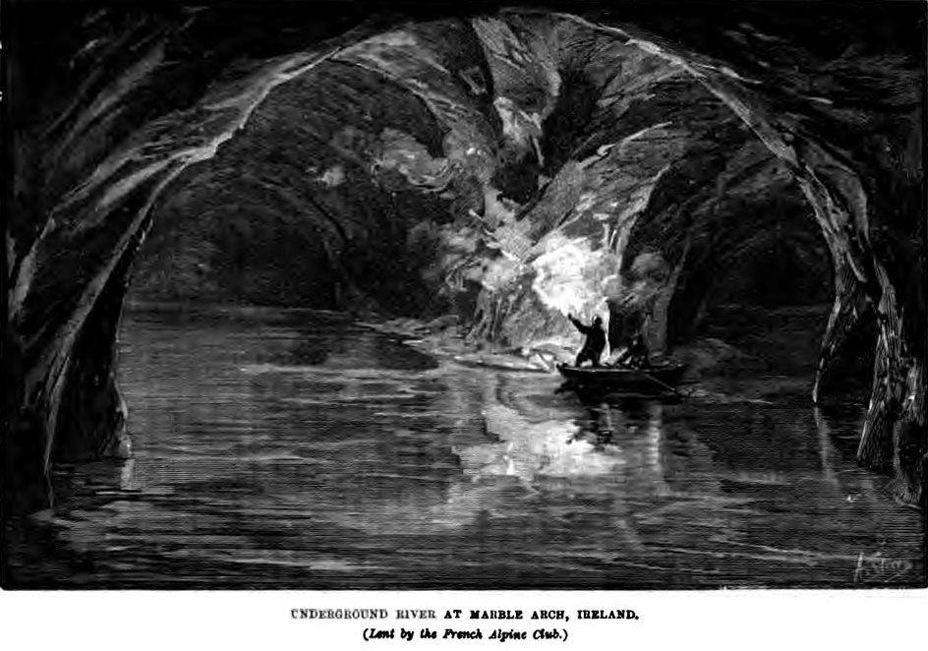
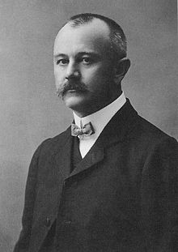
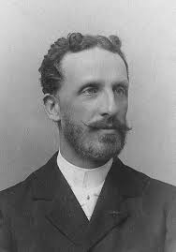
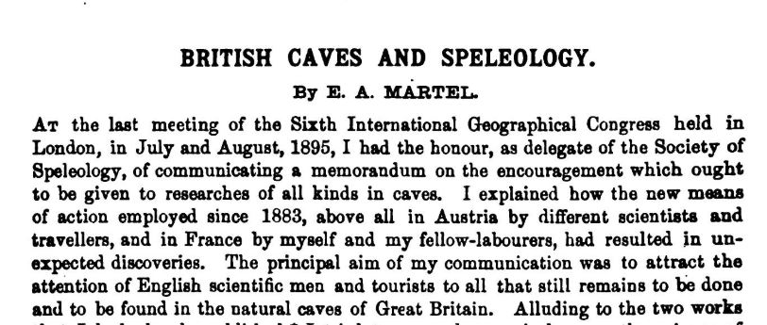
WHO?
WHEN?
1893
1895
1921
Jovan Cvijic
Edourd- Alfred Martel
Karst Hydrogeology – Who, What, Why, Where, When and How (I. Sasowsky)

Slide 8
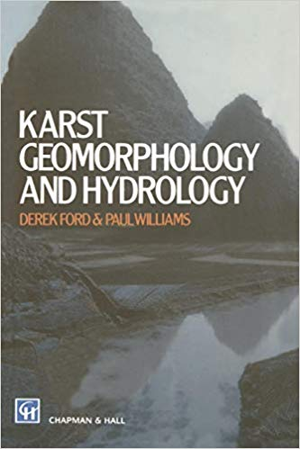
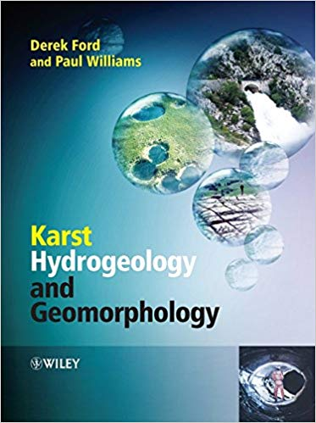
WHEN?
1981
1988
1989
2007
Karst Hydrogeology – Who, What, Why, Where, When and How (I. Sasowsky)

Slide 9
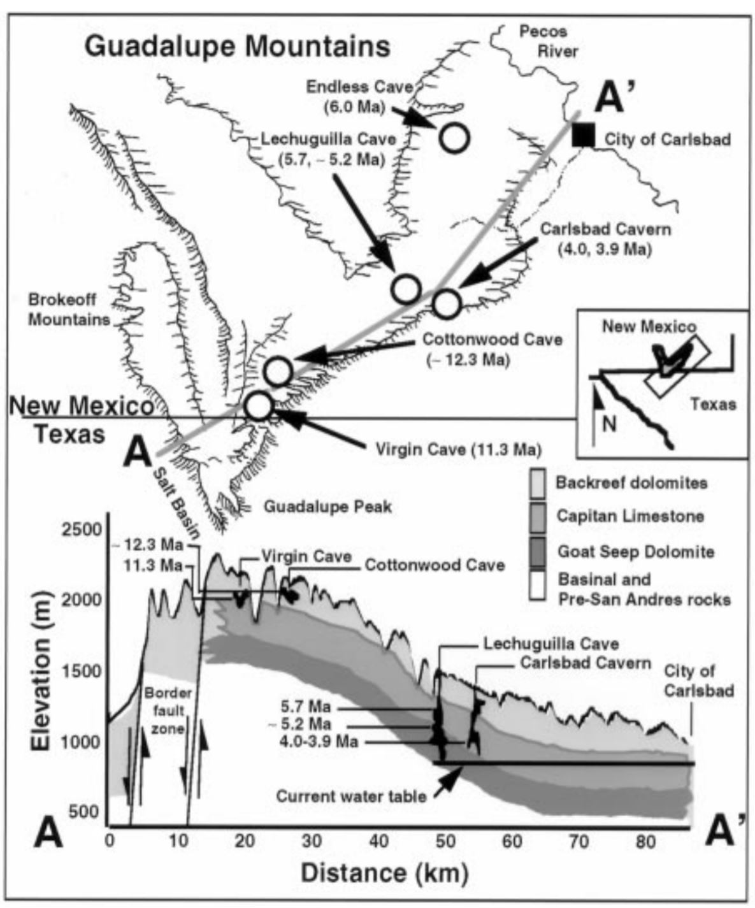
WHY?
Where is the water coming from?
Where is it going?
How much water is there?
Is the water safe to drink?
Karst Hydrogeology – Who, What, Why, Where, When and How (I. Sasowsky)

Slide 10
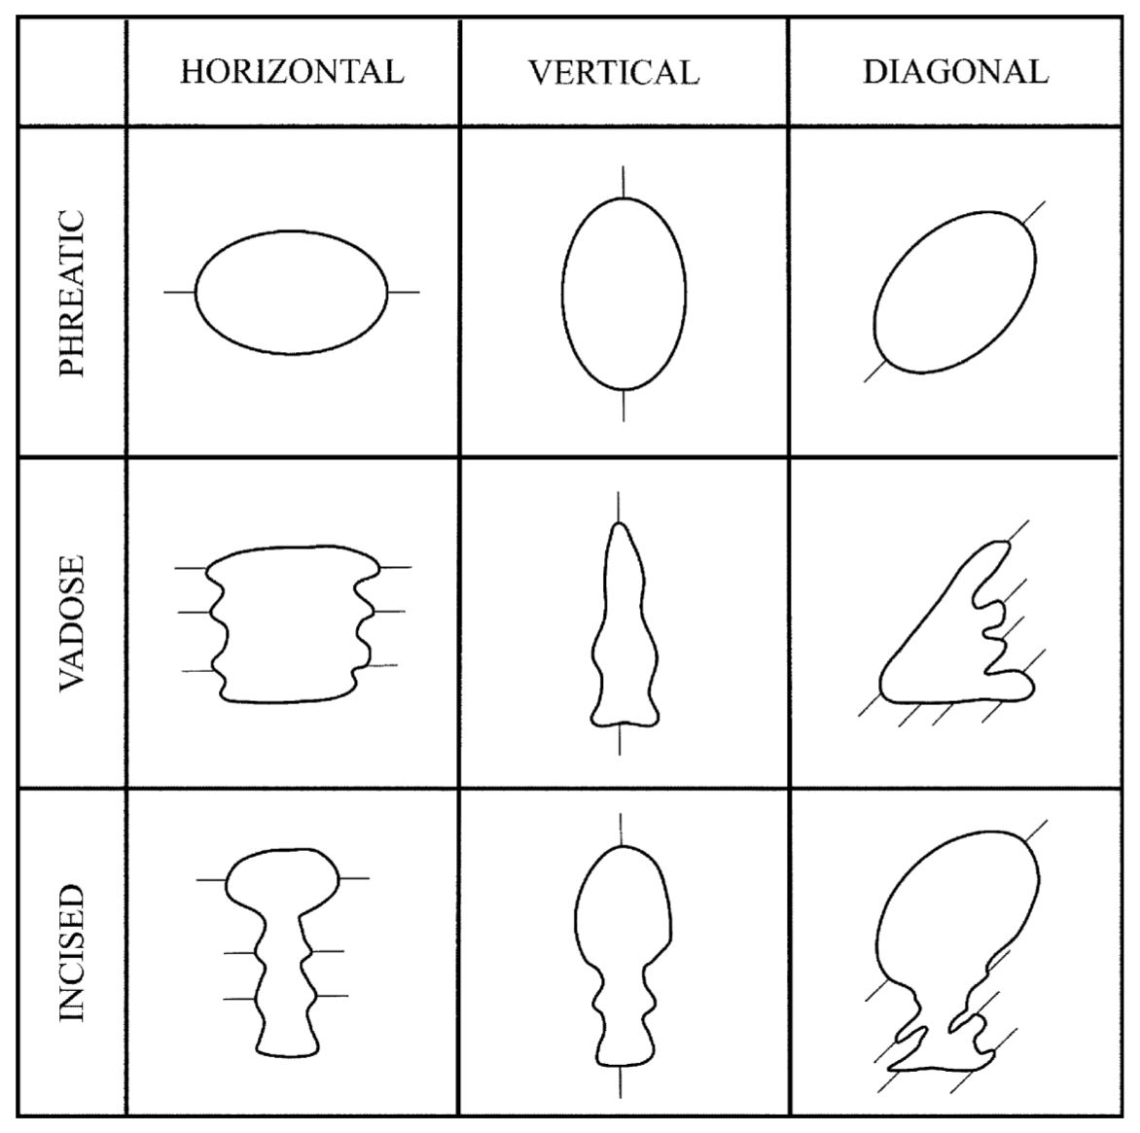
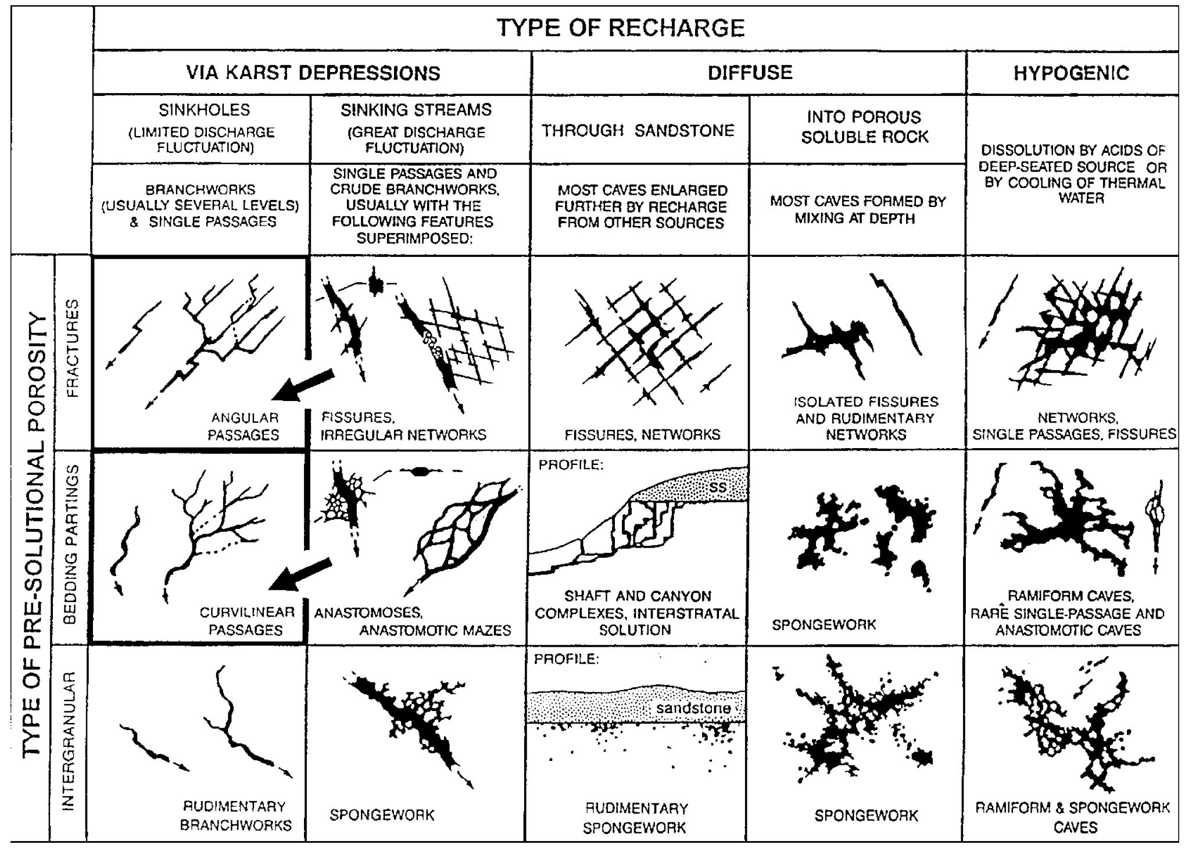
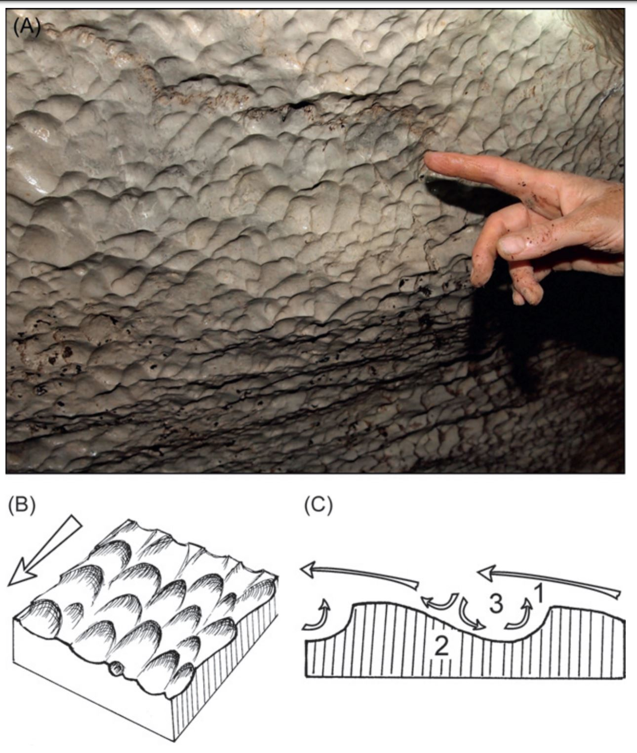
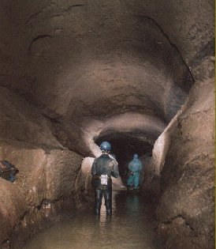
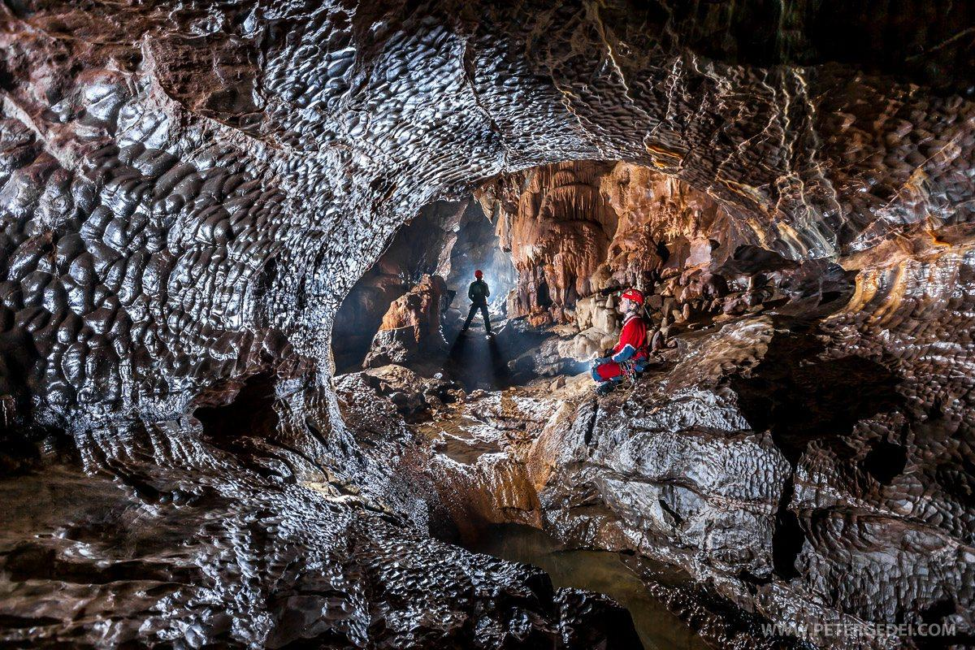
HOW?
(Palmer, 1991)
(Palmer, 1991)
(White & Culver, 2012)
SCALLOPS
PASSAGE MORPHOLOGY
CAVE MORPHOLOGY
Karst Hydrogeology – Who, What, Why, Where, When and How (I. Sasowsky)

Slide 11
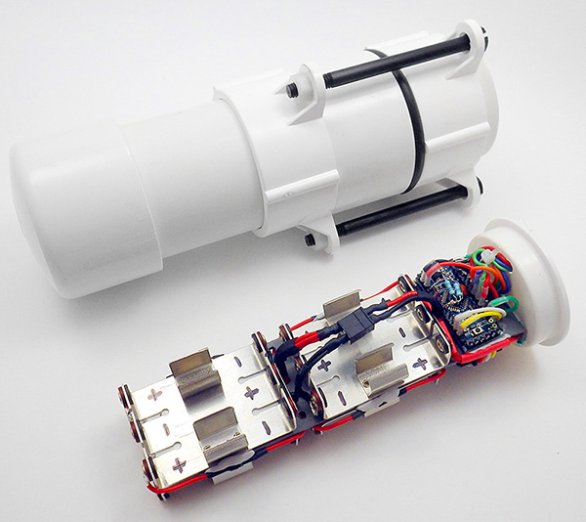
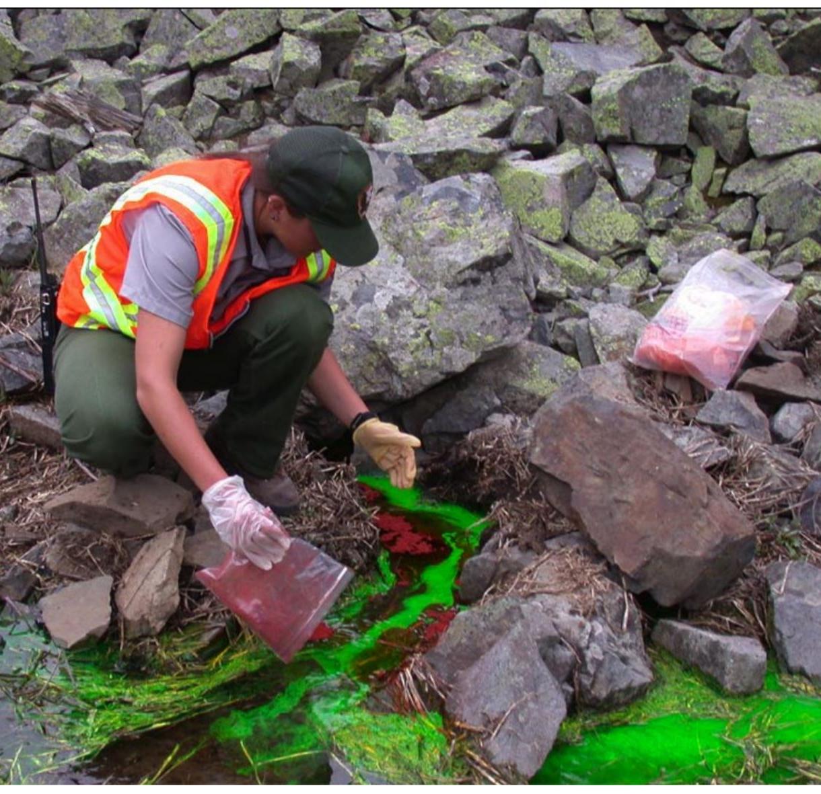
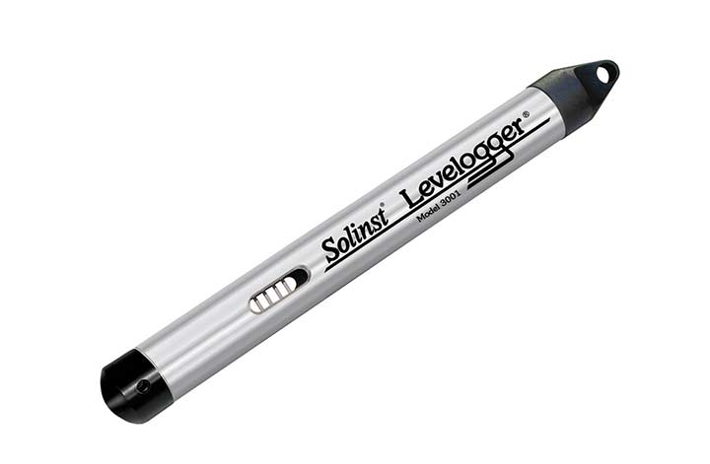
HOW?
https://pubs.usgs.gov
GPSForestry-suppliers.com
WATER WELL MONITORING
DYE TRACING
DATA LOGGERS
Karst Hydrogeology – Who, What, Why, Where, When and How (I. Sasowsky)

Slide 12
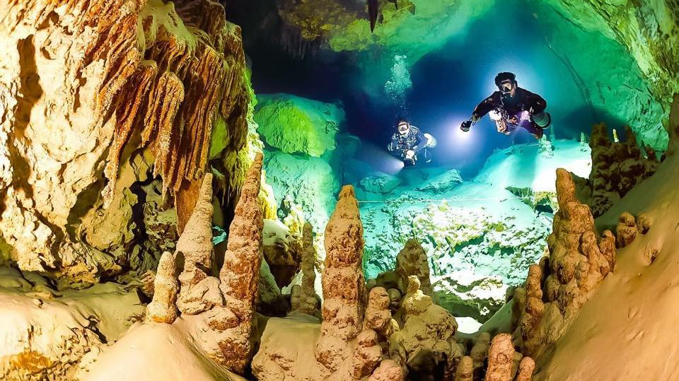
http://tiny.cc/mil09y
CAVE DIVING
Karst Hydrogeology – Who, What, Why, Where, When and How (I. Sasowsky)

Slide 13
SESSION 1: KARST HYDROGEOLOGY – PAST, PRESENT AND FUTURE
Invited Lecture:
Karst Hydrogeology–Who, What, Why, Where, When & How (I. Sasowsky)
Structural control on water circulation in the Bossea karst system – Piedmont Italy
(A. Nannoni)
Comprehensive hydraulic and hydrochemical interpretation of a karst area in South Hungary
(K. Csondor)
The Châtaigniers cave (Ardèche, France): an indicator of Pleistocene variations and Combe d’Arc meander shortcut
(K. Genuite)
Karst Hydrogeology: The high-flow low-storage extreme in marble aquifers
(T. Faulkner)
Basin-scale conceptual groundwater flow model for carbonate regions
(A. Tóth)
Photo by: IKS ZASU

Slide 14
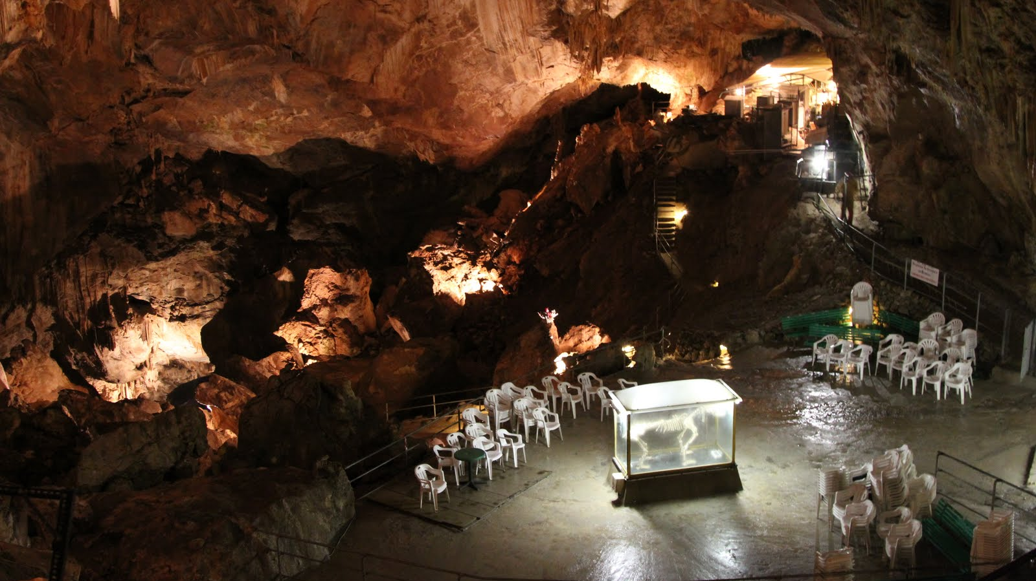
Structural control on water circulation in the Bossea karst system – Piedmont Italy
(A. Nannoni)
thegoldenscope.com
Notes:
This paper is a study on the _____
Bossea Cave is home to an underground scientific laboratory that monitors cave air, radon concentration, cave fauna, and subterranean waters.
The objective of this study is to understand the relationship of the structural setting and the water flow path of the bossea karst system.

Slide 15
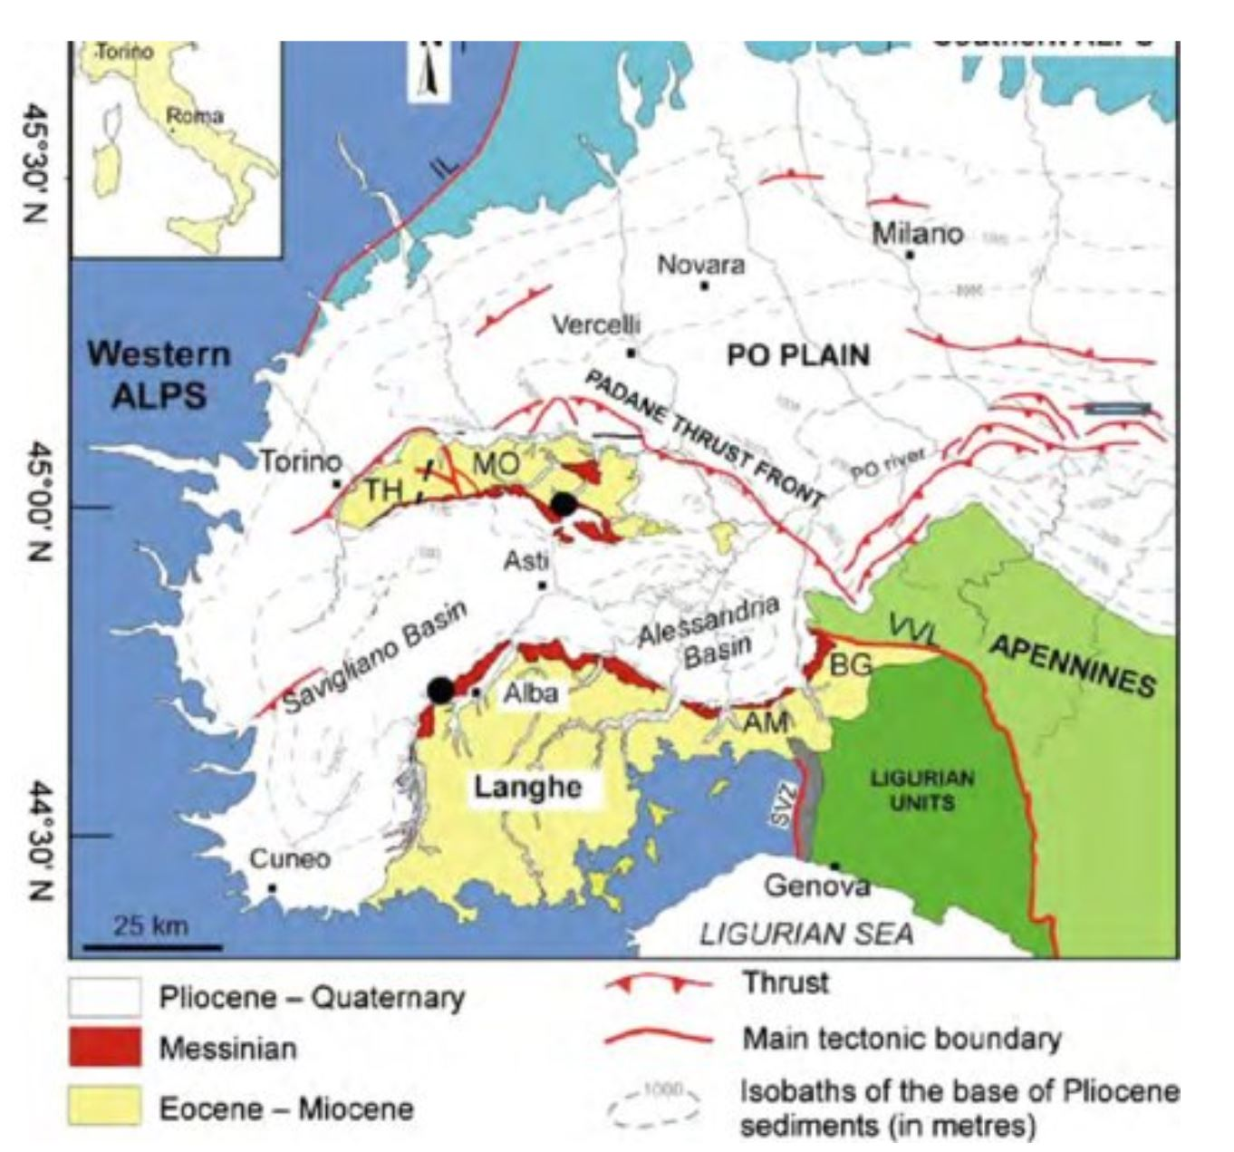
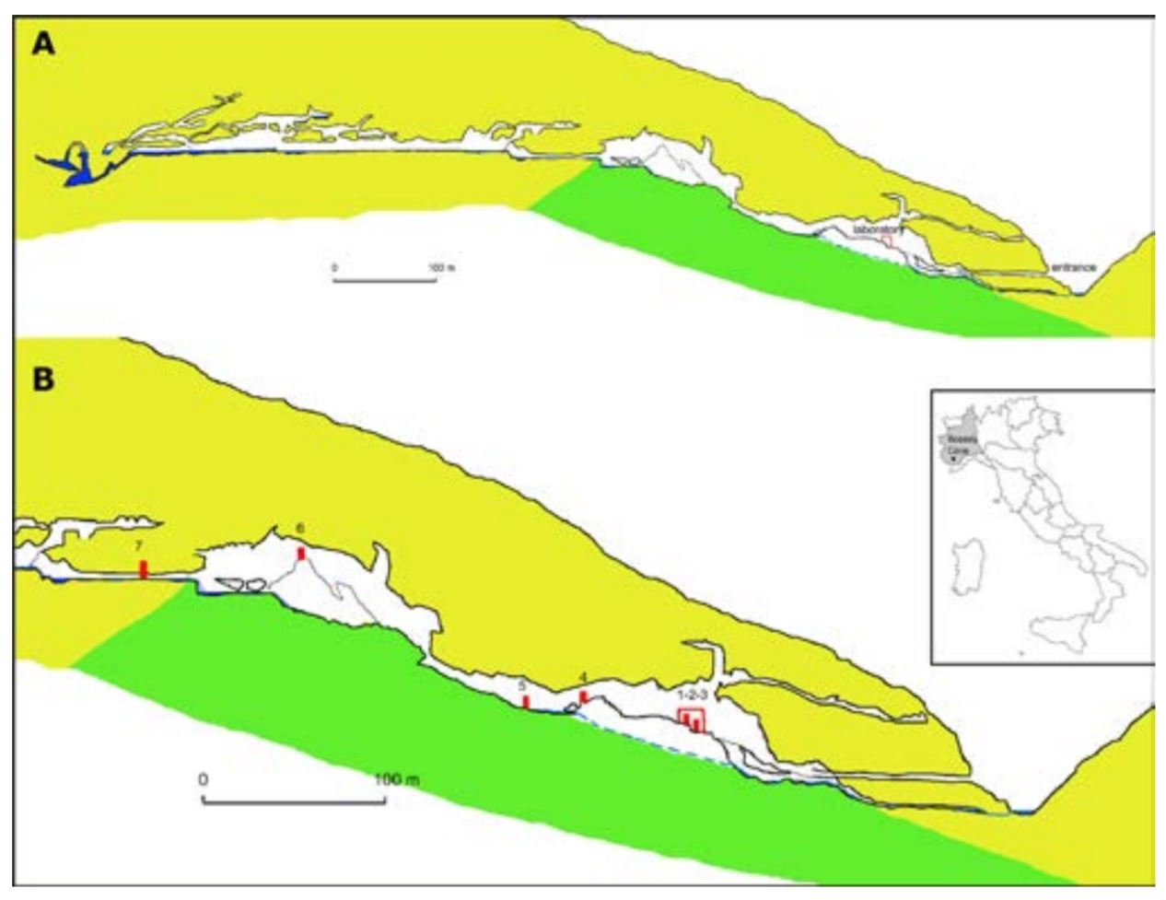
(Vigna et al., 2017)
Structural control on water circulation in the Bossea karst system – Piedmont Italy (A. Nannoni)

Slide 16
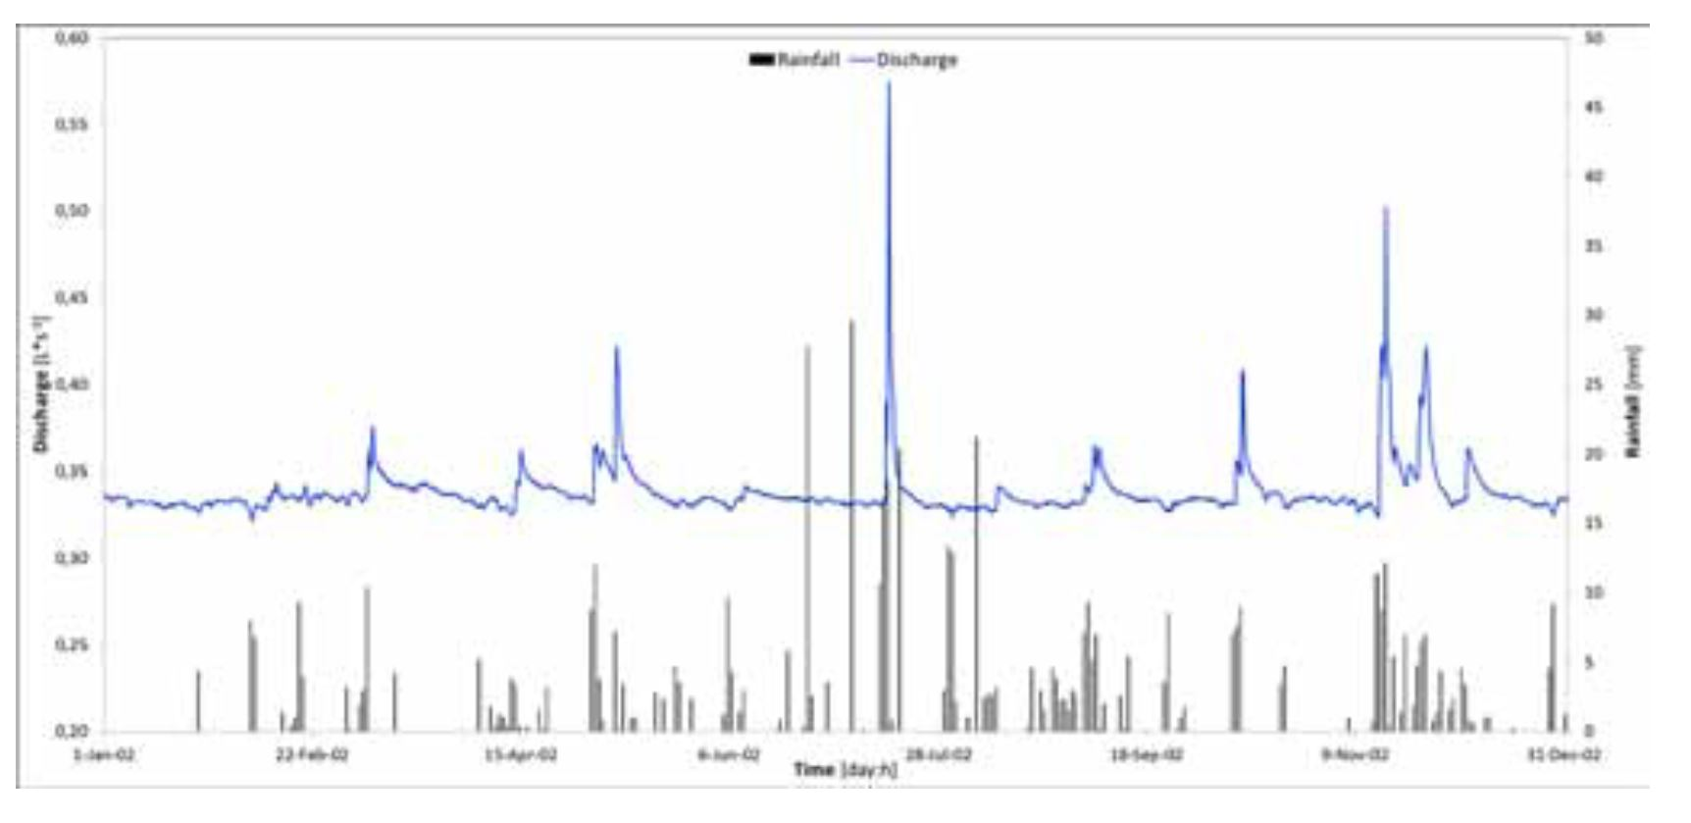
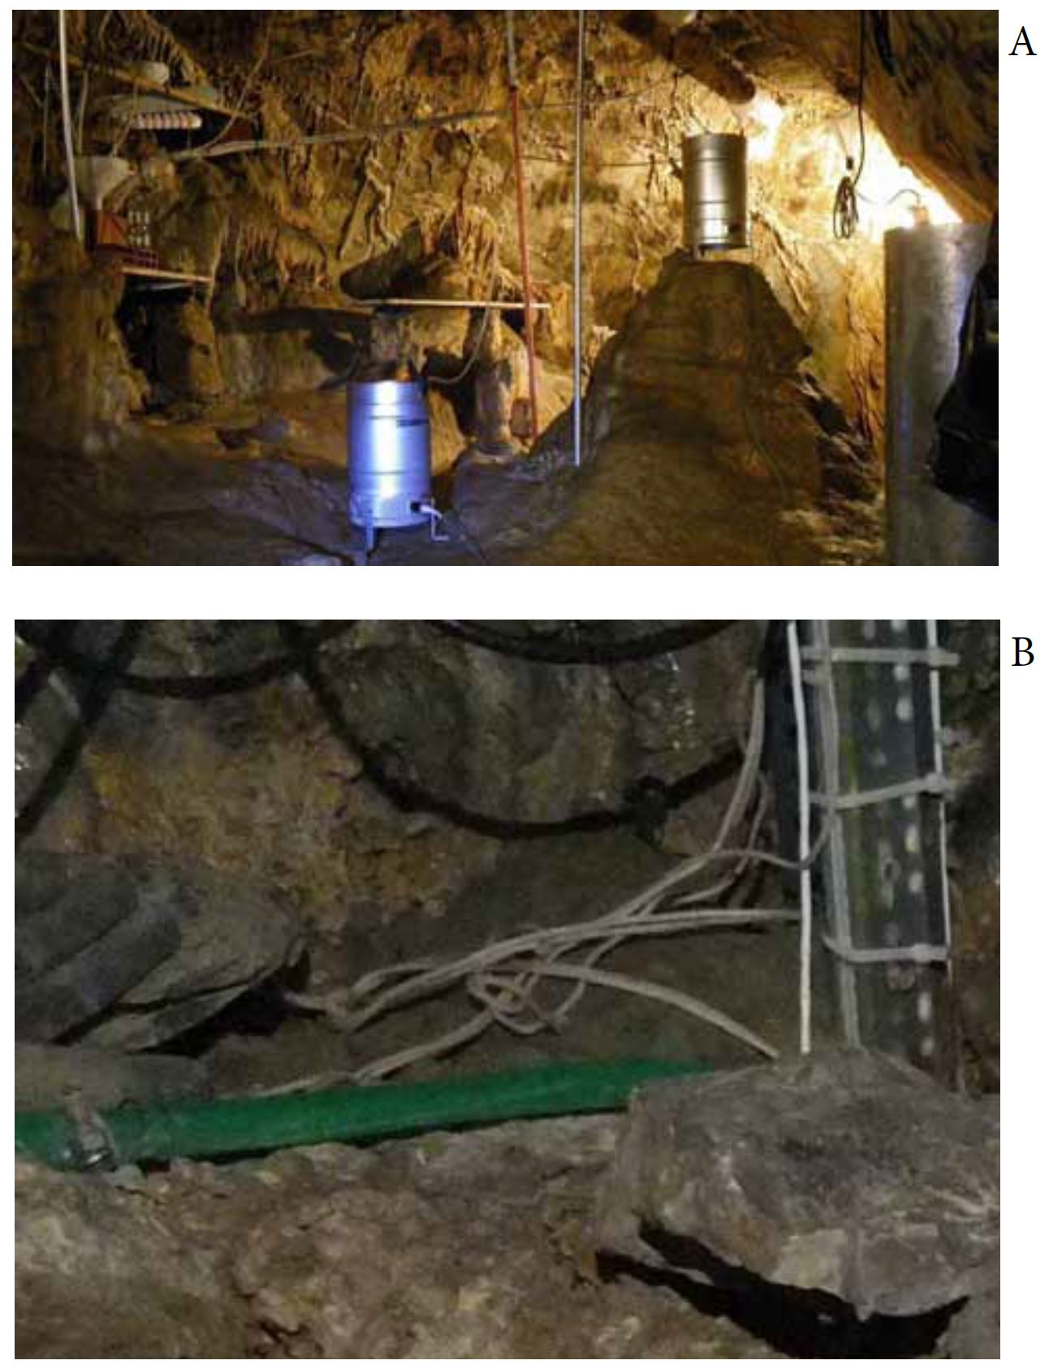
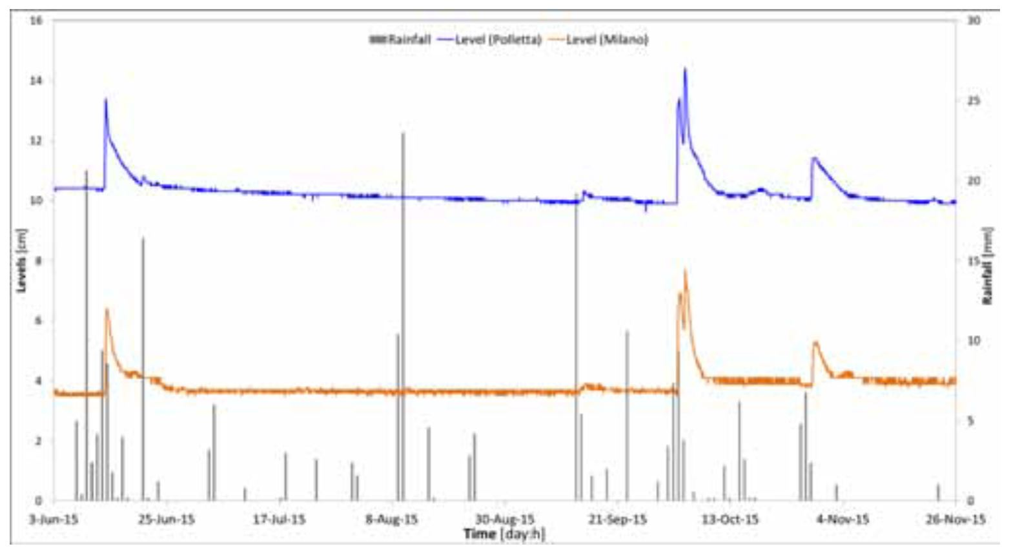
(Vigna et al., 2017)
Flow rates were found to remain constant which indicates a very stable baseflow.
Slow drips in the cave respond in a very quick manner to the rain events.
Structural control on water circulation in the Bossea karst system – Piedmont Italy (A. Nannoni)

Slide 17
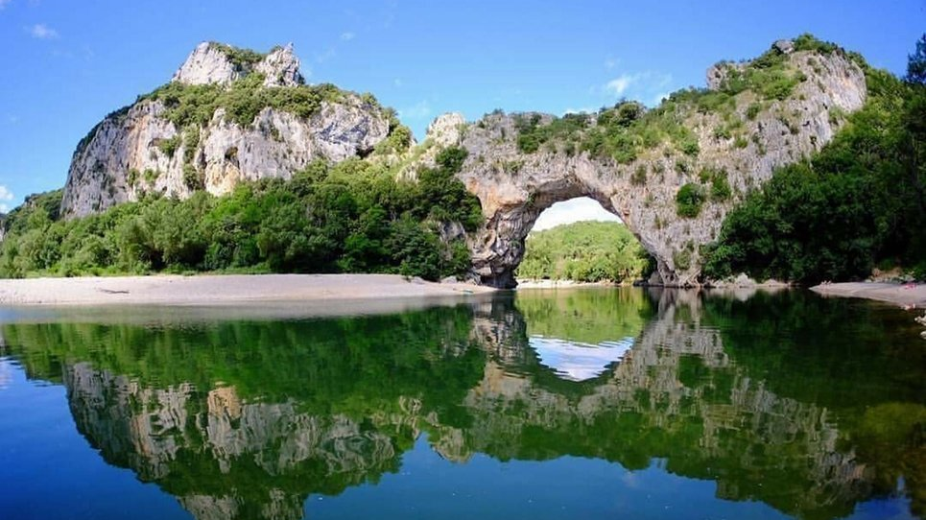
www.tourist-paradise.com
The Châtaigniers cave (Ardèche, France): an indicator of Pleistocene variations and Combe d’Arc meander shortcut
(K. Genuite)

Slide 18
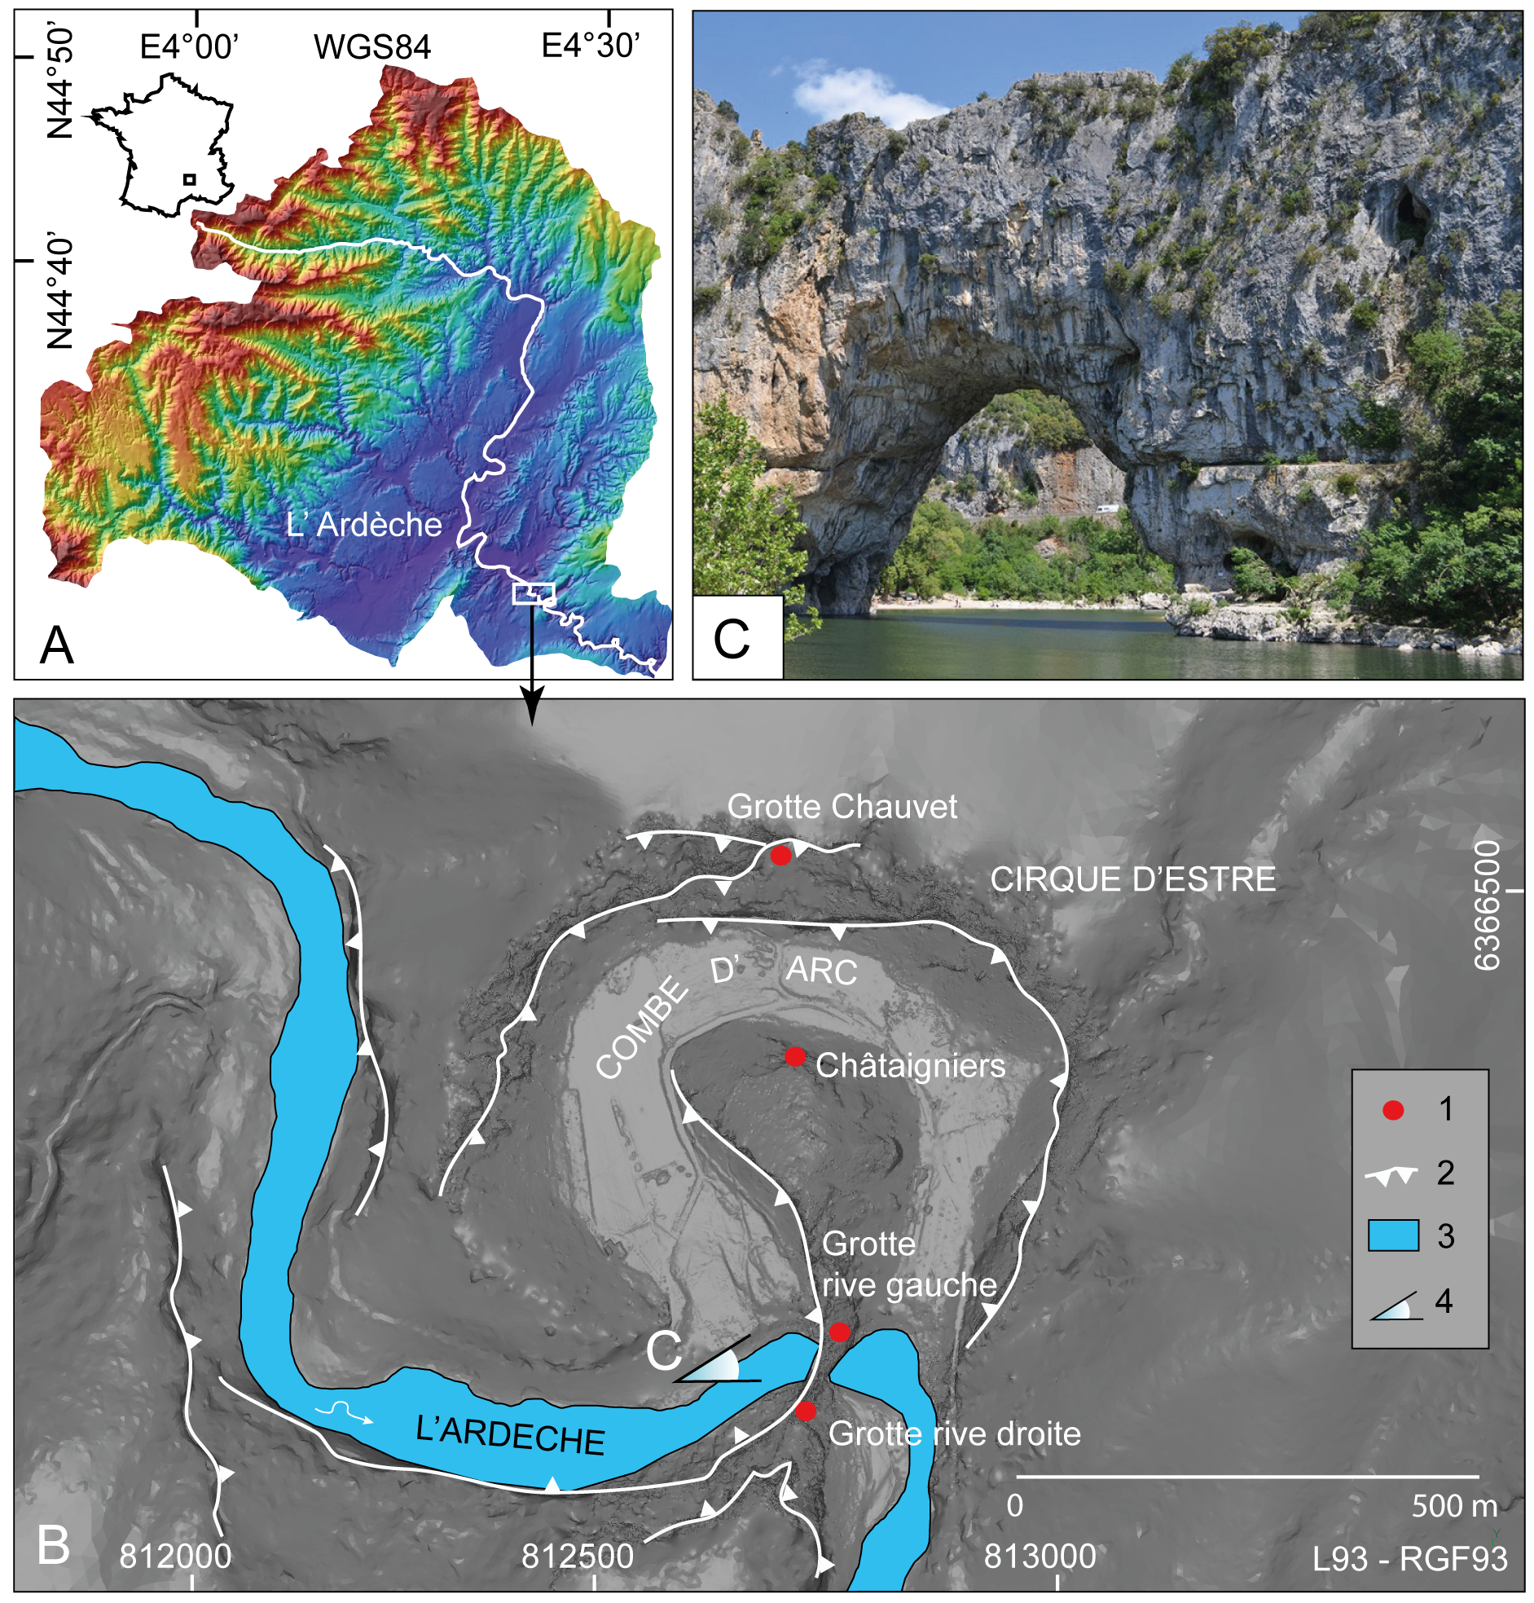
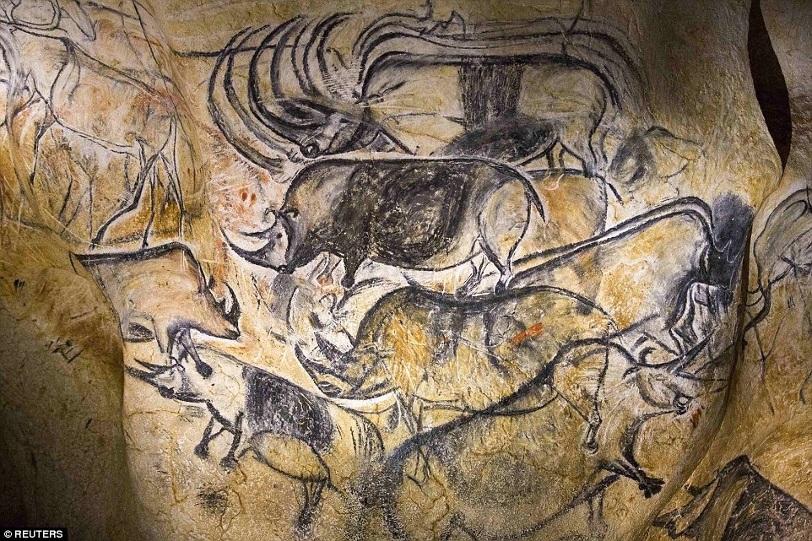
(Genuite et al., 2019 )
https://www.amusingplanet.com
How did the the river and the endokarst interacted during the river incision and the short-cutting process?
The Châtaigniers cave (Ardèche, France): an indicator of Pleistocene variations and Combe d’Arc meander shortcut (K. Genuite)

Slide 19
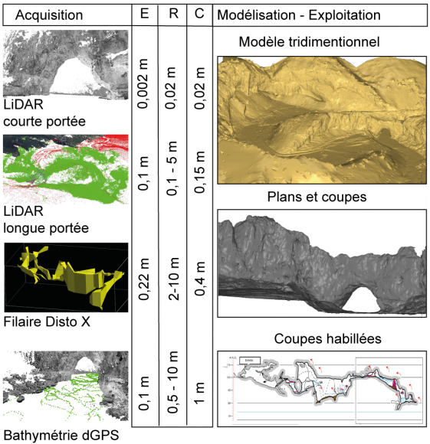
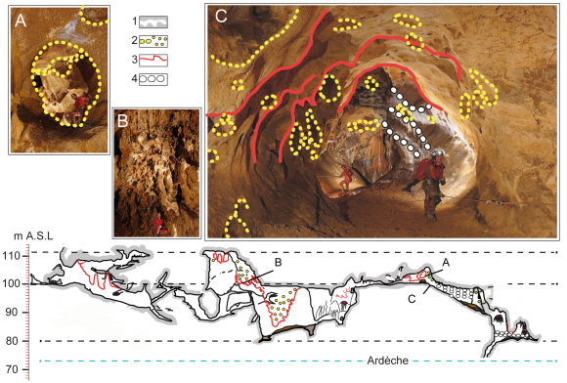
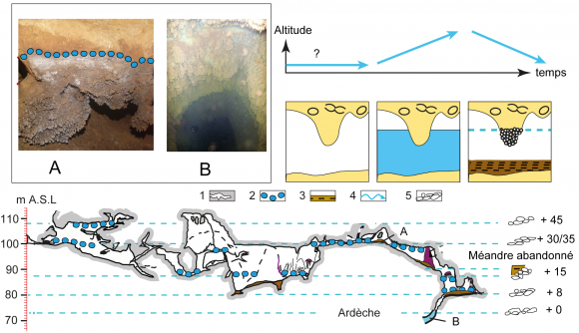
(Genuite et al., 2019 )
The Châtaigniers cave (Ardèche, France): an indicator of Pleistocene variations and Combe d’Arc meander shortcut (K. Genuite)

Slide 20
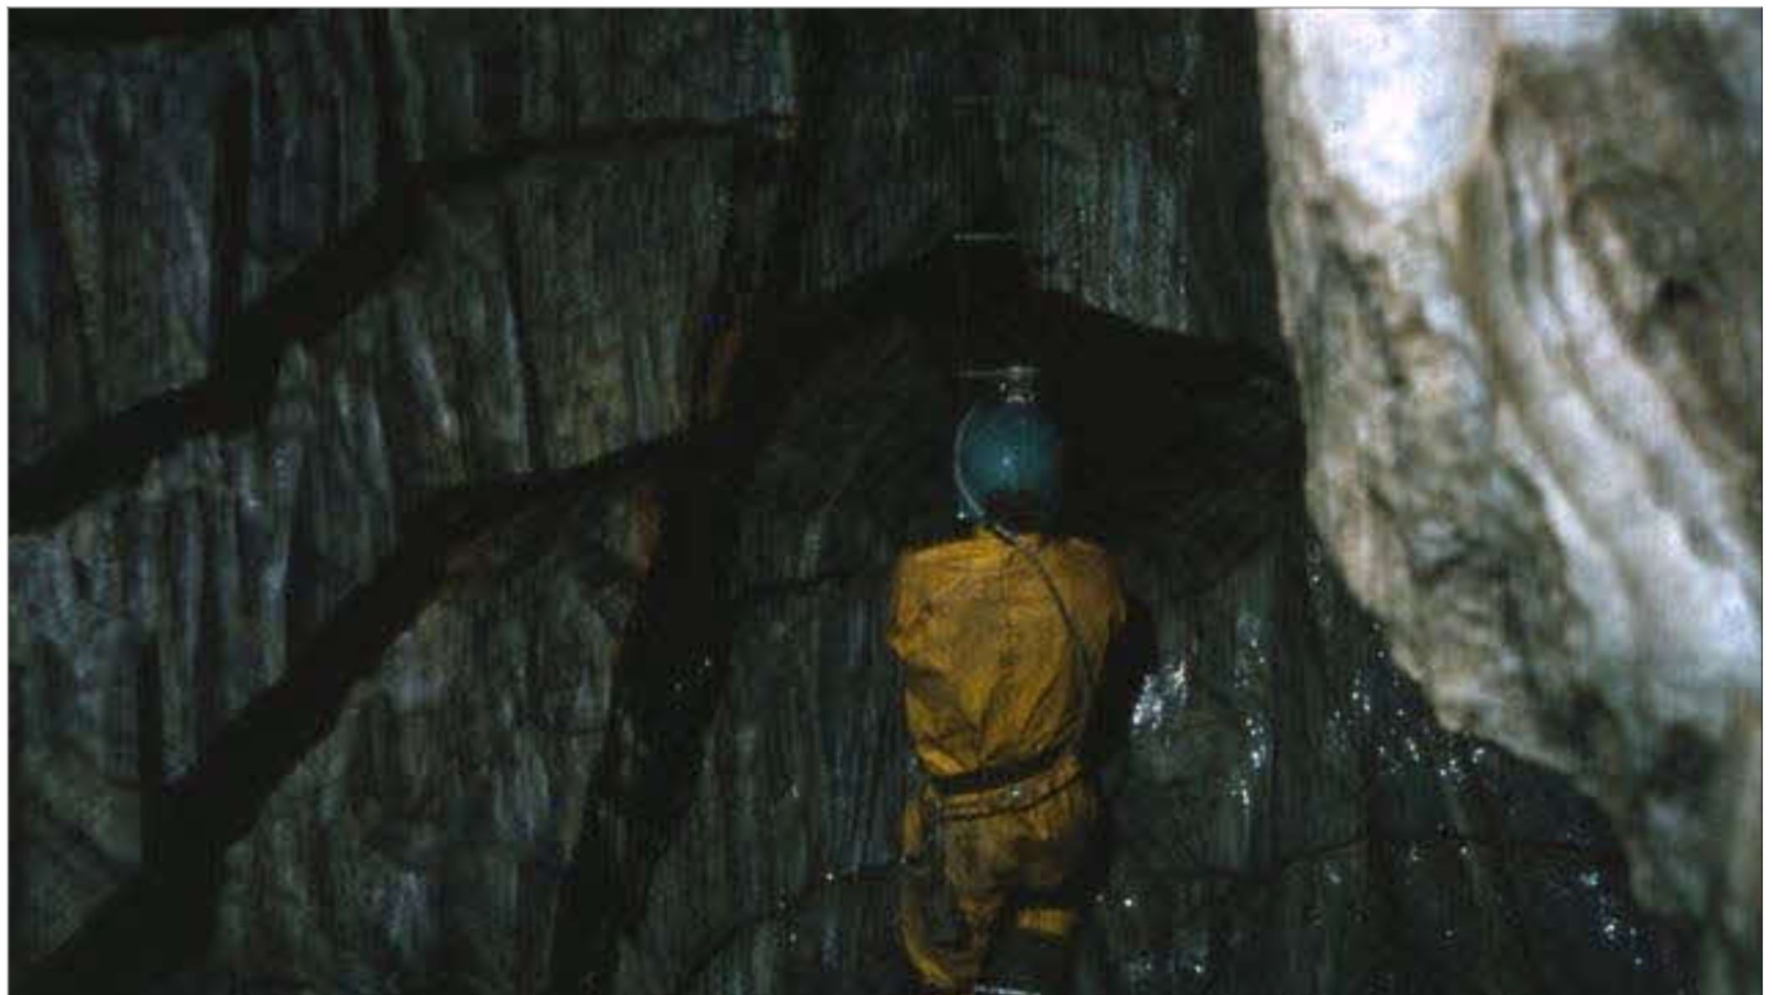
Karst Hydrogeology: The high-flow low-storage extreme in marble aquifers (T. Faulkner)

Slide 21
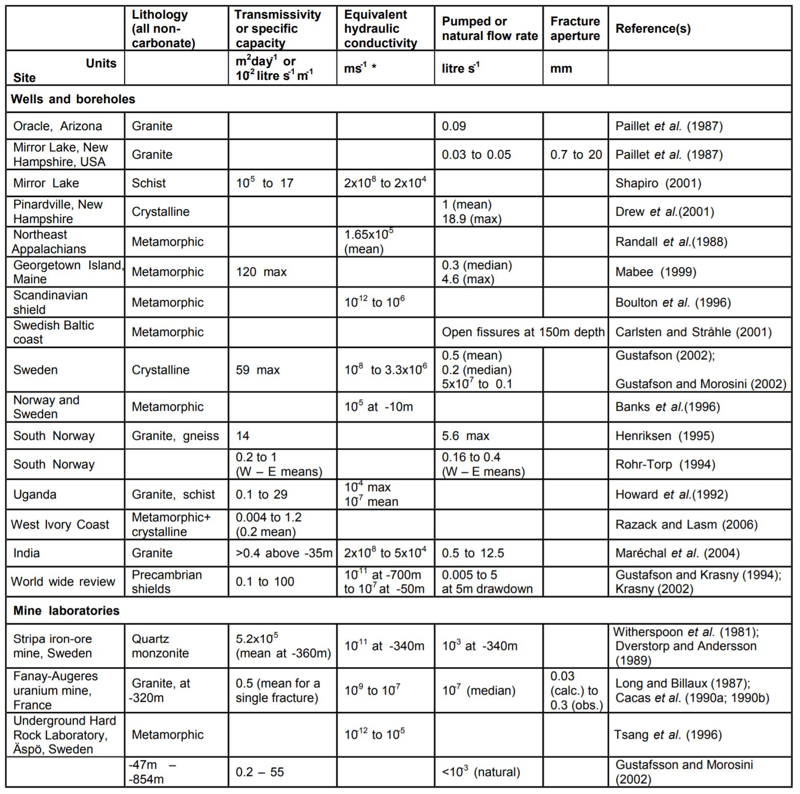
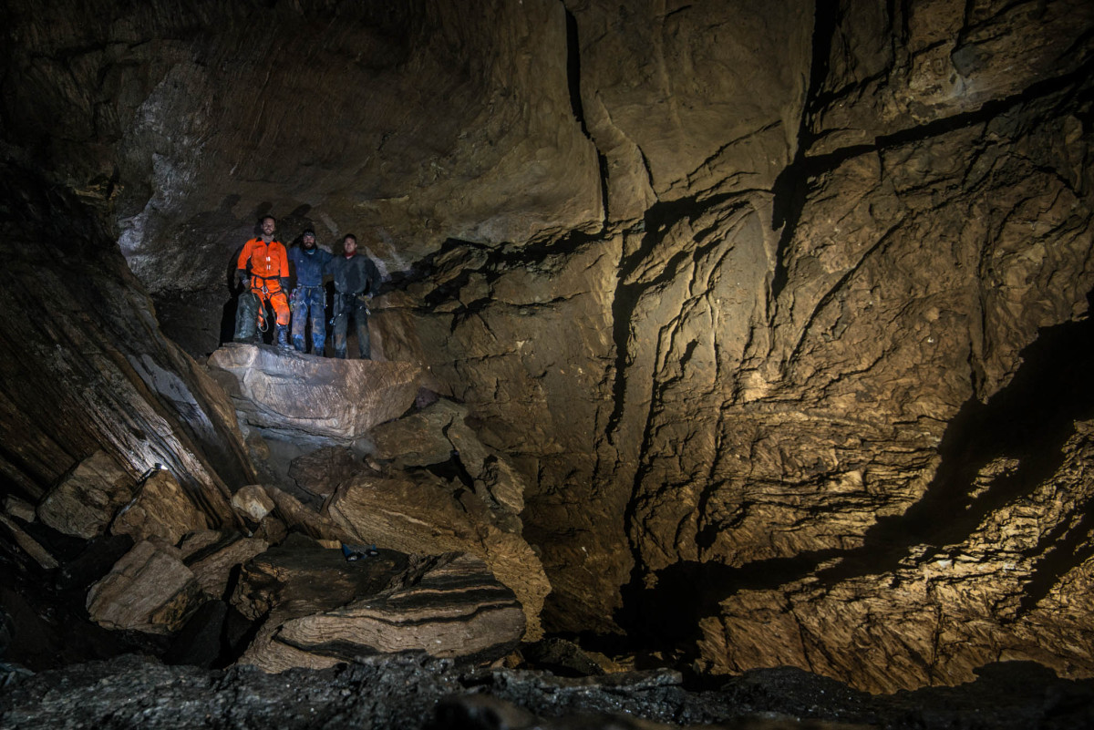
(Faulkner, 2006)
http://tiny.cc/lov99y
Raggejavreraige Cave, Norway
Karst Hydrogeology: The high-flow low-storage extreme in marble aquifers (T. Faulkner)

Slide 22
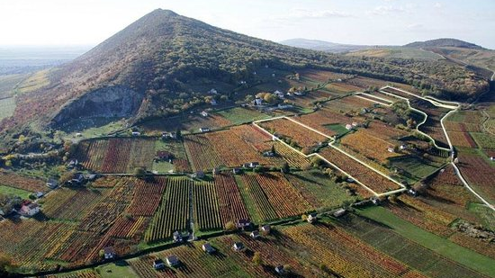
Comprehensive hydraulic and hydrochemical interpretation of a karst area in South Hungary
https://www.tripadvisor.com.my
(K. Csondor)
Photo Credit

Slide 23
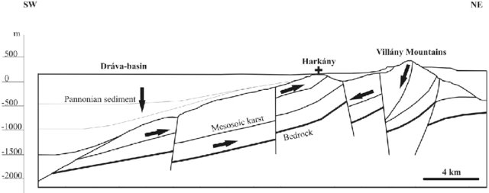
Comprehensive hydraulic and hydrochemical interpretation of a karst area in South Hungary (K. Csondor)

Slide 24
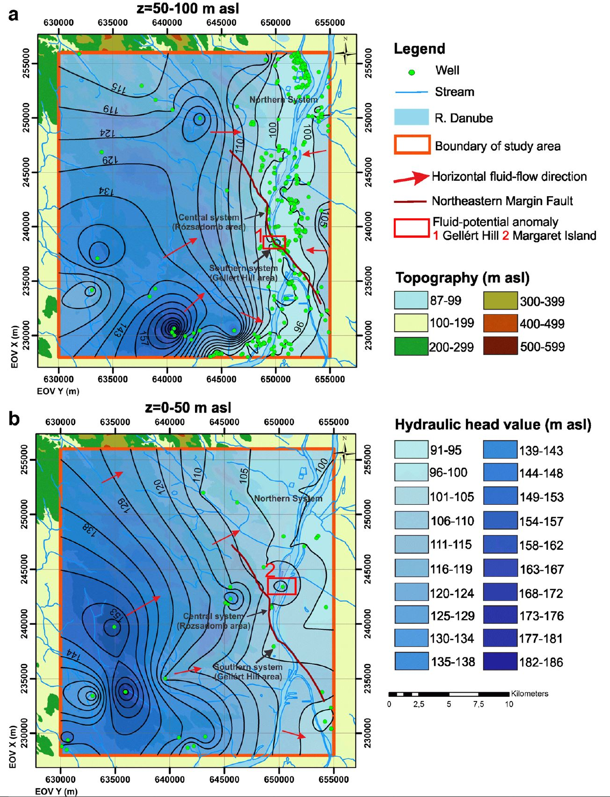
Applied Methods: (Csondor, 2019)
Hydraulic Potential of the Fluid potential field (pressure elevation profile, tomography potential map)
Numerical Simulation (regional water flow)
Dissolution Experiments (using limestone tablets)
Stable Isotopes using Radon
(Erhardt et al, 2017)
(Erhardt, 2017)
Comprehensive hydraulic and hydrochemical interpretation of a karst area in South Hungary (K. Csondor)

Slide 25
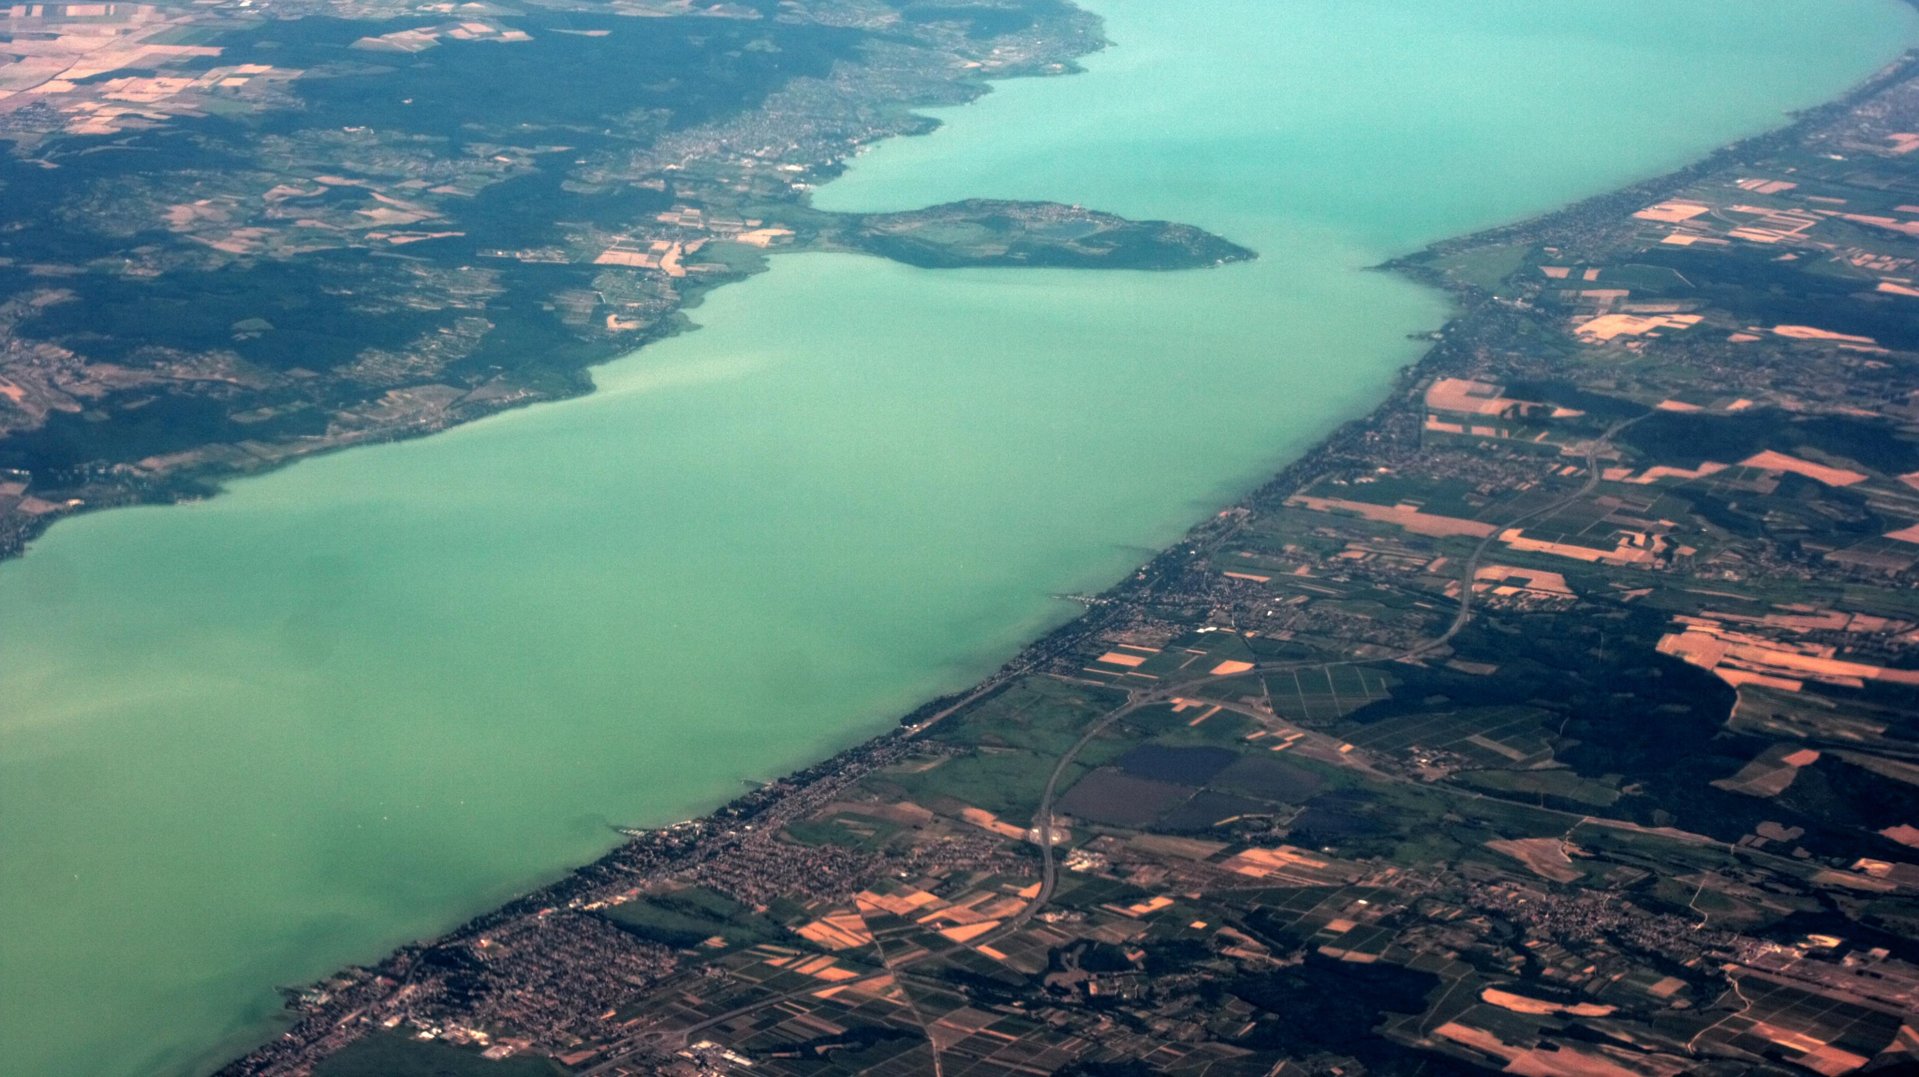
Basin Scale Conceptual Groundwater Flow Model for Carbonate Regions
http://tiny.cc/tdz19y
(A. Toth)

Slide 26
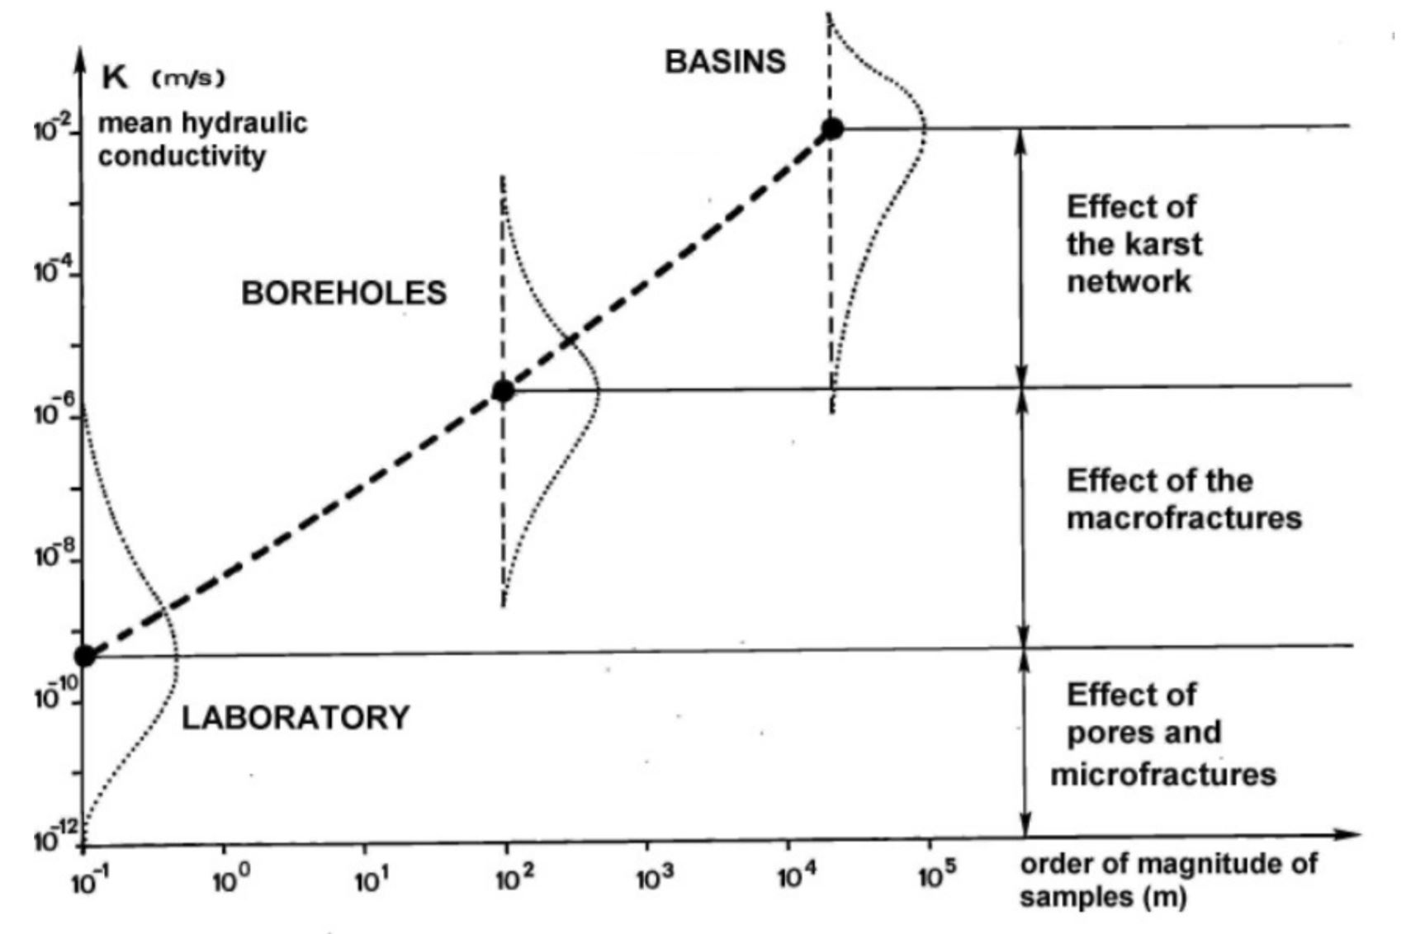
Basin-scale model may be used where Classical Karst are not applicable.
THEORETICAL CONSIDERATIONS (Toth,2015)
Gravity-driven regional groundwater flow (GDRGF) and hydraulic continuity of thick carbonate ranges
Effects of scale dependence of permeability distribution on flow in karstified carbonate regions
Springs and other surface manifestations of flowing groundwater as validation tools for GDRGF in thick carbonates
Numerical representation of the hierarchy and pattern of GDRGF systems in carbonate ranges
(Kiraly, 1975)
Basin-scale conceptual groundwater flow model for carbonate regions (A. Tóth)

Slide 27
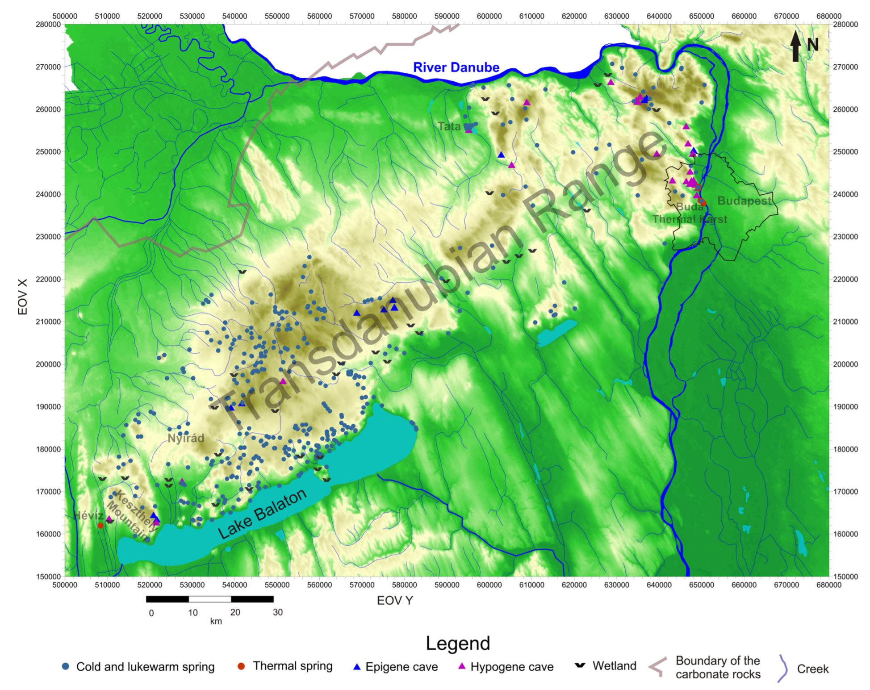
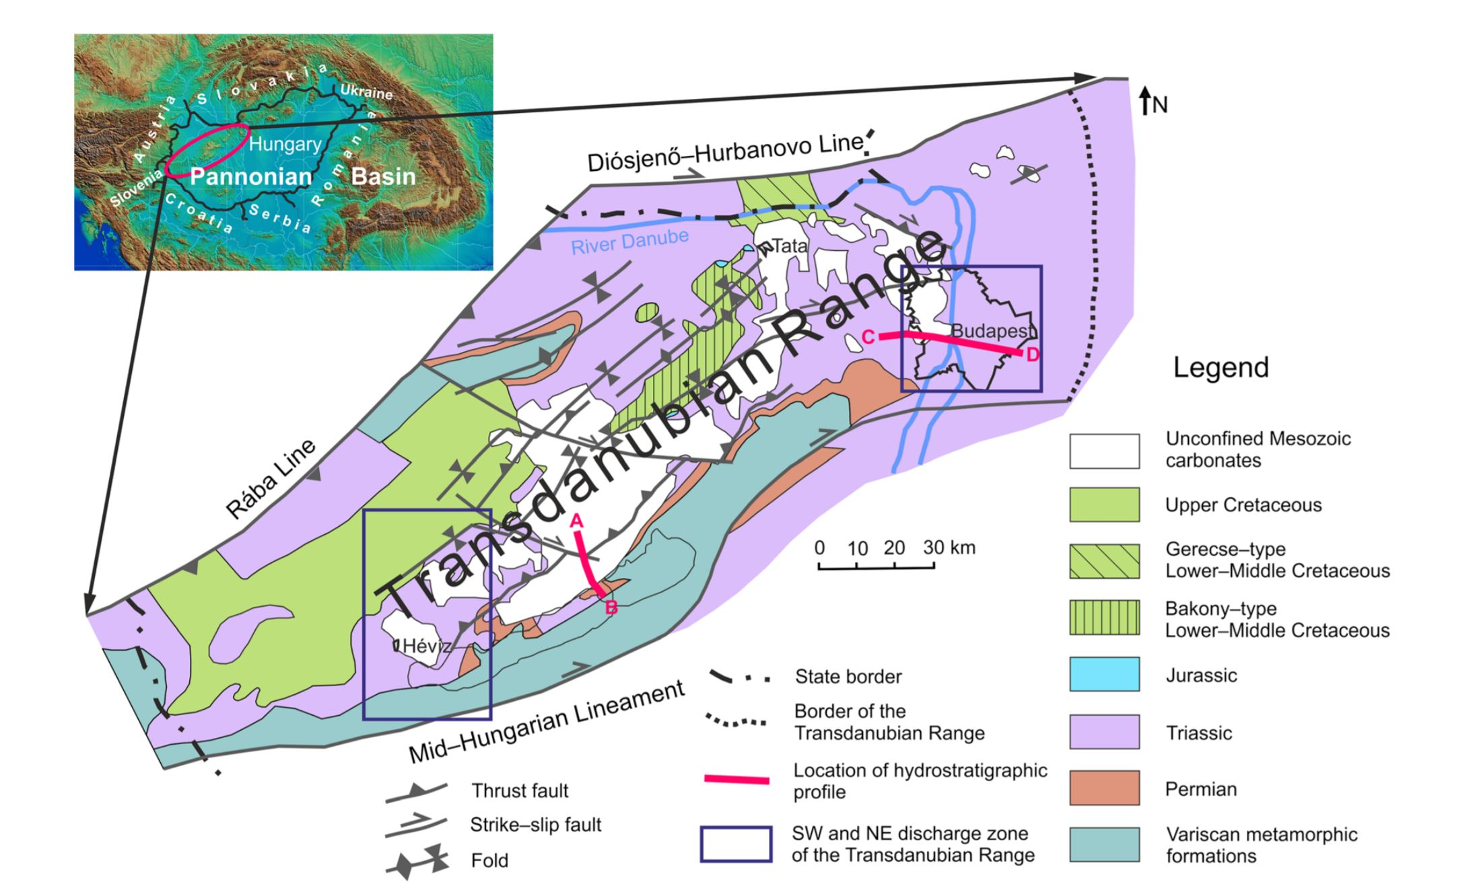
Application of the gravity-driven regional groundwater flow (GDRGF) concept to the hydrogeologically complex thick carbonate system of the Transdanubian Range, is justified based on the principle of hydraulic continuity.
Basin-scale conceptual groundwater flow model for carbonate regions (A. Tóth)

Slide 28
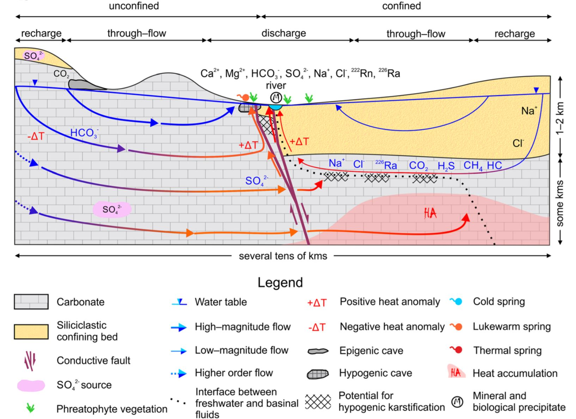
TOTHIAN TYPE FLOW
Hydraulic continuity
Unconfined and confined parts handled as a system
Topography-driven regional groundwater flow
Same methods as for siliciclastic basins
Basin-scale conceptual groundwater flow model for carbonate regions (A. Tóth)

Slide 29
Acknowledgements
Notes:
Coffee Break

Slide 30
SESSION 2: MONITORING – INSTRUMENTATION AND DATA ANALYSIS
Invited Lecture: Monitoring of Karst Water – Method and Techniques (R. Benischke)
Attempt to characterize aquifer hydrodynamics with modern analytical tools using remote sensing data and on site monitoring – (Example of Mt. Miroč, Serbia) (V. Gajovič)
Water-rock interaction in Postojna Cave: Can we use stable isotopes as paleothermometer? (M. Lipar)
Interaction of air and water dynamics in deep caves of Mt. Velebit, Dinaric Karst , Croatia
(D. Paar)
Decreasing the unpredictability of karst aquifers – preliminary results of speleological and hydrological research in Učka cave system, Croatia (L. Kukuljan)
Karstic Conduits connectivity, natural and disturbed hydraulic behaviours of the multi-layered aquifer system of Barrois Limestone (H. Benabderrahmane)

Slide 31
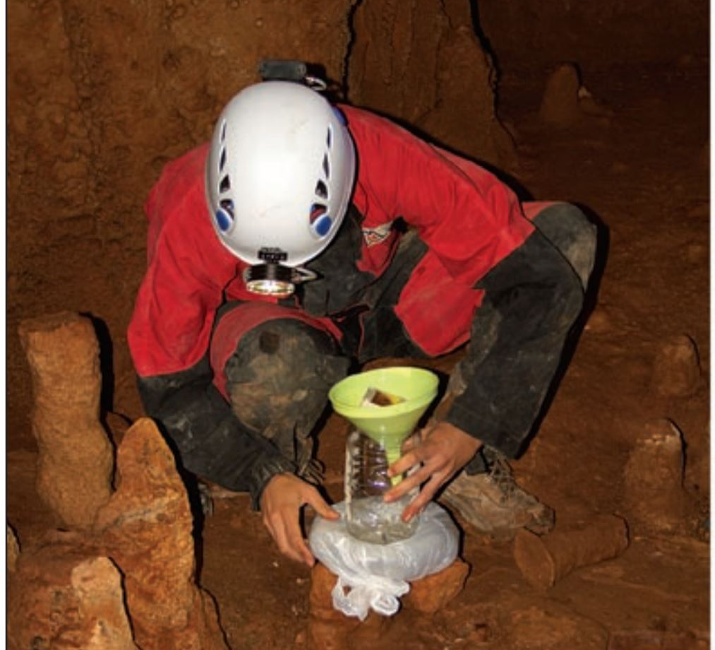
Monitoring of Karst Water Method and Techniques
(R. Benischke)

Slide 32
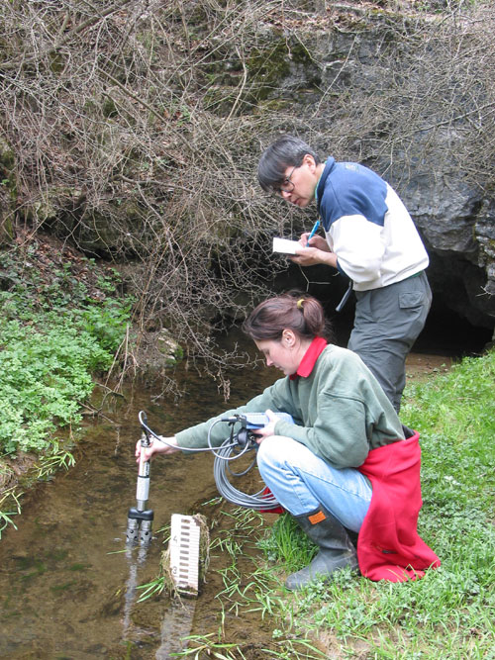
MONITORING IS A PROGRAMMED PROCESS…
SURVEY/SCREENING short term program
SURVEILLANCE
continuous, special program of measurement

Slide 33
WHAT TO MONITOR?
INPUT SYSTEM
OUTPUT SYSTEM
Atmosphere – Watershed - Catchment
Karst (springs, surface water)
http://tiny.cc/ggi69y
Precipitation, Surface Runoff,
Surface Morphology, Recharge Conditions,
Soil cover, Geology, Vegetation, Anthropogenics,
Monitoring of Karst Water – Method and Techniques (R. Benischke)

Slide 34
WHAT TO MEASURE?
HYDROMETEOROLOGIC PARAMETERS
CHEMICAL AND PHYSICAL PARAMETERS
HYDROMETEOROLOGIC PARAMETERS
Precipitation
Water Level
Water Flow Velocity
Air Temperature
Wind Parameters
Radiation Parameters
Inorganic and organic components (ions, PAH, undissociated components etc..)
Bulk parameters (electric conductivity, SAC)
Water Temperature
Turbidity, colour
Isotopes (stable, radiogenic)
Biological PArameters
Macro-zoobenthos
Microbiology
Enzymatic activity …
Monitoring of Karst Water – Method and Techniques (R. Benischke)

Slide 35
Parameter | Manual | Online | Instrument | Logger | Sampling
Precipitation | ✓ | ✓ | Rain gauge, weighing, etc. | ✓
Air temperature | ✓ | ✓ | Handheld, probe | ✓
Stage | ✓ | ✓ | Height gauge | ✓
Flow Rate | ✓ | ✓ | Current meter, tracer, ADV | ✓
Water Temperature | ✓ | ✓ | Handheld, probe | ✓
Rel. Conductivity | ✓ | ✓ | Handheld, probe | ✓ | ✓
pH-Value | ✓ | ✓ | Handheld, probe | ✓ | ✓
Turbidity | ✓ | ✓ | Handheld, probe, UV/VIS | ✓ | ✓
SAC | ✓ | ✓ | Handheld, probe, UV/VIS | ✓ | ✓
O2 | ✓ | ✓ | Handheld, amperometry, fluorescence quenching | ✓ | ✓
Cations | ✓ | ✓ | Handheld, ion-selective probe | ✓ | ✓
Anions (no alkalinity) | ✓ | ✓ | Handheld, ion-selective prove, UV/VIS | ✓ | ✓
Alkalinity | ✓ | extensive | Manual titration, titrator | ✓ | ✓
Flourescence | ✓ | extensive | Field or lab fluorometer | ✓ | ✓
Radioisotopes | ✓ | extensive | Field-probe or lab instrument | ✓ | ✓
Stable Isotopes | ✓ | extensive | Field-probe or ab instrument | ✓ | ✓
Microbiology | ✓ | extensive | Field-probe or lab instrument, cytometry | ✓ | ✓
Monitoring of Karst Water – Method and Techniques (R. Benischke)

Slide 36
PARAMETER AND SENSOR SELECTION
Selectivity for reliable Data
Sensivity fo accurate Data
No Cross-sensitivity with other parameters
High temporal and spatial resolution
Robustness of individual sensors and sensor networks for rough field conditions
Long-term stability to minimize maintenance work and costs
Cheap and easy to operate sensors
(Kluge et al. (2008)
Monitoring of Karst Water – Method and Techniques (R. Benischke)

Slide 37
WHERE TO SAMPLE?
https://quaternary.uibk.ac.at/Methods/Cave-Monitoring.aspx
Monitoring of Karst Water – Method and Techniques (R. Benischke)

Slide 38
HOW LONG TO OBSERVE?
https://quaternary.uibk.ac.at/Methods/Cave-Monitoring.aspx
Monitoring of Karst Water – Method and Techniques (R. Benischke)

Slide 39
(Kluge et al., 2010).
UNDER WHAT CONDITIONS?
Monitoring of Karst Water – Method and Techniques (R. Benischke)

Slide 40
SESSION 2: MONITORING – INSTRUMENTATION AND DATA ANALYSIS
Invited Lecture: Monitoring of Karst Water – Method and Techniques (R. Benischke)
Attempt to characterize aquifer hydrodynamics with modern analytical tools using remote sensing data and on site monitoring – (Example of Mt. Miroč, Serbia) (V. Gajovič)
Water-rock interaction in Postojna Cave: Can we use stable isotopes as paleothermometer? (M. Lipar)
Interaction of air and water dynamics in deep caves of Mt. Velebit, Dinaric Karst , Croatia
(D. Paar)
Decreasing the unpredictability of karst aquifers – preliminary results of speleological and hydrological research in Učka cave system, Croatia (L. Kukuljan)
Karstic Conduits connectivity, natural and disturbed hydraulic behaviours of the multi-layered aquifer system of Barrois Limestone (H. Benabderrahmane)

Slide 41
Attempt to characterize aquifer hydrodynamics with modern analytical tools using remote sensing data and on-site monitoring – (Example of Mt. Miroč, Serbia)
(V. Gajovič)
http://www.panacomp.net/miroc-mountain/

Slide 42
(Ljubojevic, 2001)
Attempt to characterize aquifer hydrodynamics with modern analytical tools using remote sensing data and on site monitoring – (Example of Mt. Miroč, Serbia)
(V. Gajovič)

Slide 43
Water-rock interaction in Postojna Cave: Can we use stable isotopes as Paleothermometer?
(M. Lipar)
https://twitter.com/postojnacave
Notes:
In

Slide 44
Water and rock interaction in Postojna Cave - Can we use stable isotopes for Paleothermometer? (M. Lipar)

Slide 45
http://tiny.cc/n69z9y
Use of Radiology CT-Xray of stalagmite to pre-screen samples
http://tiny.cc/v99z9y
http://tiny.cc/s89z9y
Water and rock interaction in Postojna Cave - Can we use stable isotopes for Paleothermometer? (M. Lipar)

Slide 46
Interaction of air and water dynamics in deep caves of Mt. Velebit, Dinaric Karst , Croatia
(D. Paar)
http://www.panacomp.net/miroc-mountain/

Slide 47
Develop model of cave air situation to understand the presence of perennial ice and interaction of water and other physical processes.
http://speleologija.eu/lukinajama
http://speleologija.eu/lukinajama
Interaction of air and water dynamics in deep caves in Mt. Velebit, Dinaric Karst, Croatia (D. Paar)

Slide 48
(Stroj & Paar, 2018)
Interaction of air and water dynamics in deep caves in Mt. Velebit, Dinaric Karst, Croatia (D. Paar)

Slide 49
(Stroj & Paar, 2018)
Interaction of air and water dynamics in deep caves in Mt. Velebit, Dinaric Karst, Croatia (D. Paar)

Slide 50
Decreasing the unpredictability of karst aquifers – preliminary results of speleological and hydrological research in Učka cave system, Croatia
(L. Kukuljan)

Slide 51
A Hydrological and microclimate monitoring was established in Ucka cave in 2018
Preliminary results already came up mapping at least 4.1km of cave that goes to a depth of 427m.
Decreasing the unpredictability of karst aquifers – prelim results of speleological and hydrological research in Učka cave system, Croatia (L. Kukuljan)

Slide 52
Karstic conduits connectivity, natural and disturbed hydraulic behaviours of the multi-layered aquifer system of Barrois Limestone
(H. Benabderrahmane)

Slide 53
The karstic geometry is modelled using a formulation of the stochastic differential equation of Langevin.
Karstic Conduits connectivity, natural and disturbed hydraulic behaviours of the multi-layered aquifer system of Barrois Limestone (H. Benabderrahmane)

Slide 54
Acknowledgements

